Slide 1


Slide 2

Monday, January 2nd 2026
Jobs
Unit
12
Lesson 2

Slide 3

Warm-up

Slide 4



Contents
.
Listen and number.
Look, complete and read.
Let’s play.

Slide 5


Facebook : Bùi Liễu
0968142780
Let’s play!

Slide 6






PLAY
BASEBALL CUP

Slide 7





A. farmer
B. singer

Slide 8

A. singer
B. doctor

Slide 9
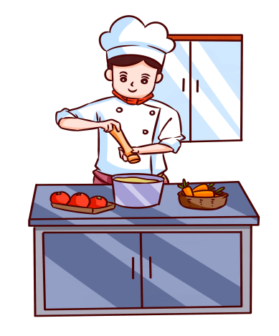
A. singer
B. cook

Slide 10

A. teacher
B. nurse

Slide 11

A. Yes, she is.
B. No, she isn’t.
She’s a singer.
Is she a driver?

Slide 12

A. No, she isn’t.
She’s a teacher.
B. Yes, she is.
Is she a doctor?

Slide 13

A. Are
B. Is
______ he a farmer?
Yes, he is.

Slide 14

A. No
B. Yes
Is he a doctor?
______, he isn’t. He’s a singer.

Slide 15

A. an
B. a
Is he __ farmer ?

Slide 16
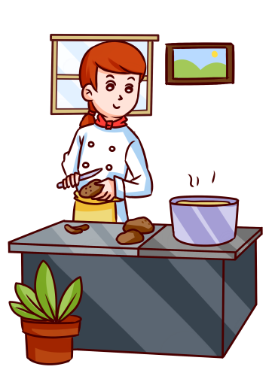
A. Is she a cook
B. Is she a driver
__________?
Yes, she is.

Slide 17
CONGRATULATION!
PLAY
TIME’S UP!

Slide 18


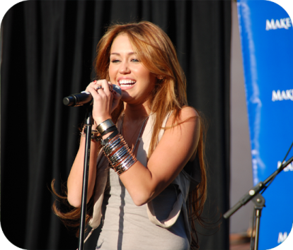
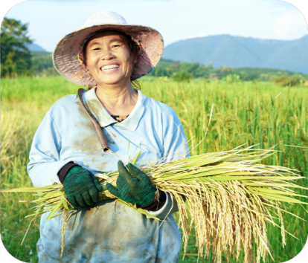





4. Listen and number.
a
b
c
d
3
2
4
1
Click on the pots to hear.

Slide 19

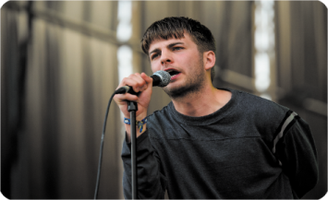

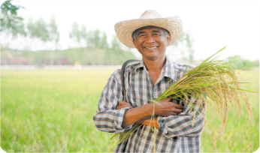
5. Look, complete and read.
1. A: Is she a nurse?
B: Yes, ________.
she is
2. A: Is he a driver?
B: No, ________. He’s a ______.
he isn’t
singer
3. A: Is she a cook?
B: _____, ________.
Yes
she is
4. A: Is he a singer?
B: ____, he isn’t. He’s a ______.
No
farmer

Slide 20
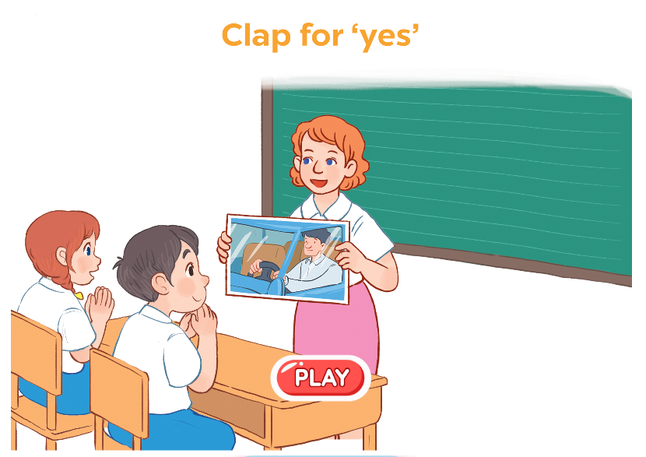
6. Let’s play.
Is he a driver?
Yes, he is.

Slide 21
Let’s play!

Slide 22







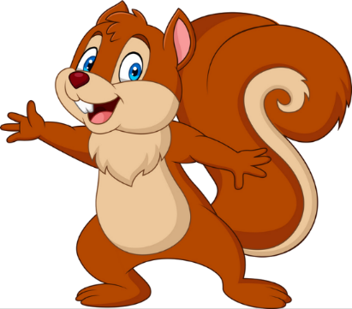
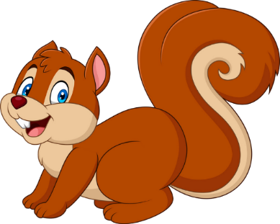
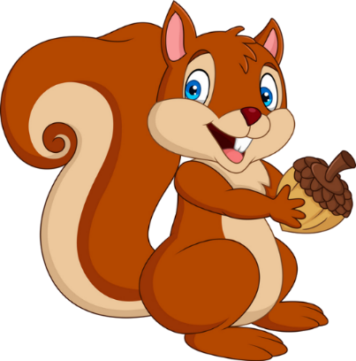


Slide 23




A. nurse
B. cook

Slide 24

A. singer
B. nurse

Slide 25
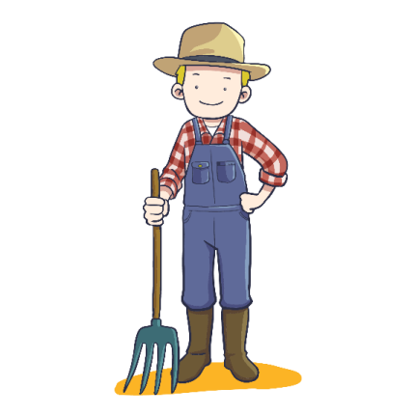
A. cook
B. farmer

Slide 26

A. nurse
B. teacher

Slide 27
sing_ _
A. ur
B. er

Slide 28
f_ _mer
A. ar
B. er

Slide 29
Is he a cook?
A. Yes, he is.
B. No, he isn’t. He’s a farmer.

Slide 30

Is she a nurse?
A. Yes, she is.
B. No, she isn’t. She’s a farmer.

Slide 31

Is he a singer?
_____, he isn’t.
He’s a cook.
A. Yes
B. No

Slide 32
__ he a farmer?
A. Are
B. Is

Slide 33
Is __ a singer?
Yes, __ is.
A. she
B. he

Slide 34
__________
Yes, he is.
A. Is he a doctor?
B. Is he a cook?

Slide 35


EXIT

Slide 36
Homelink
Learn by heart all the new words
and the model sentences.
Read again in part 5.

Slide 37

Facebook : Bùi Liễu
0968142780
Thank you!

