Slide 1


Slide 2
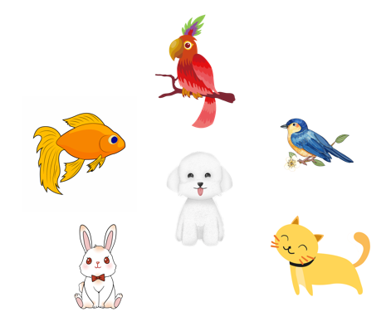
Monday, February 25th 2024
Unit 16
My pets
Lesson 1
Facebook: Bùi Liễu
0968142780

Slide 3
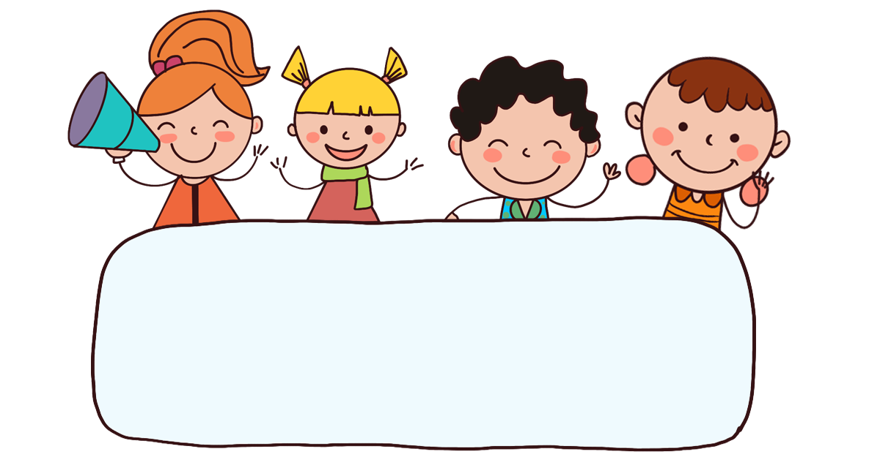
Warm-up

Slide 4

Let’s sing.

Slide 5



Contents
Look, listen and repeat.
Listen, point and say.
Let’s talk.
.

Slide 6

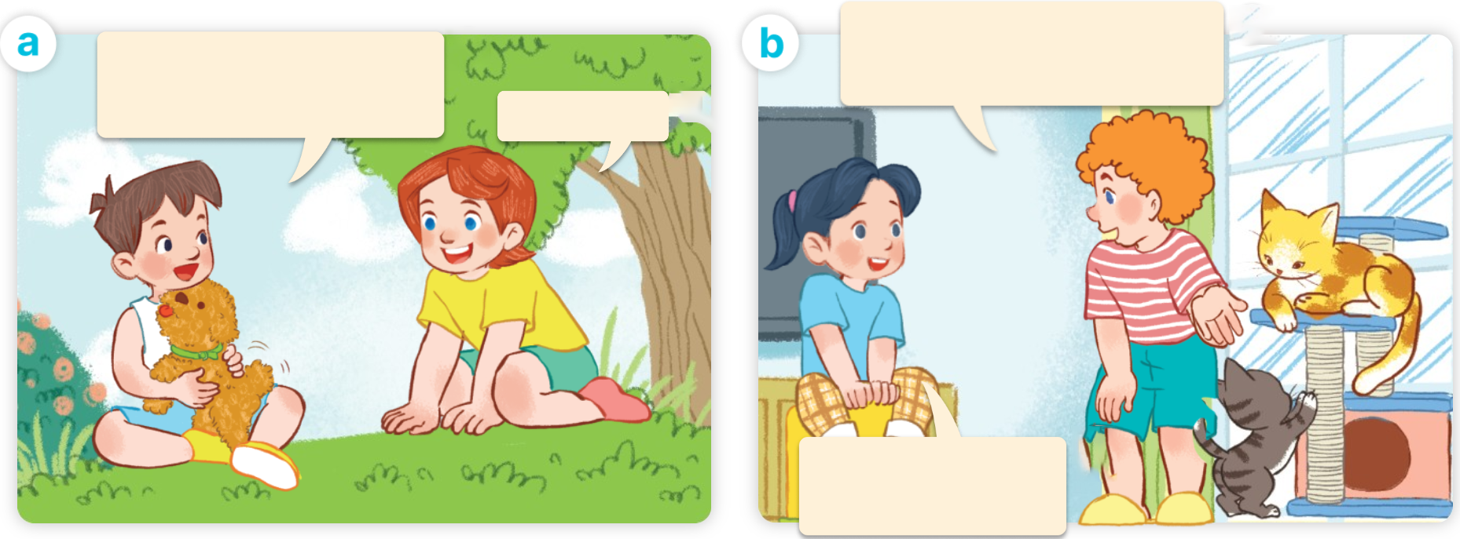
1. Look, listen and repeat.
Click on the speaker / sentences to listen.
I have two cats.
Do you have any cats?
I have a dog.
Do you have any dogs?
Yes, I do.
No, I don’t.
I have one dog.
Who are they?
What are they doing?
Where are they?

Slide 7
Vocabulary

Slide 8
Vocabulary
pets
/pets/
những con thú cưng
Click on the English word to listen again.

Slide 9
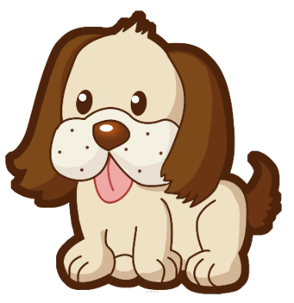


dog
dogs
/dɒɡ/
/dɒɡz/
con chó
những con chó

Slide 10
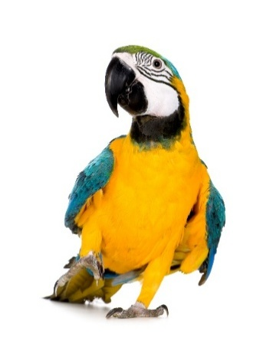
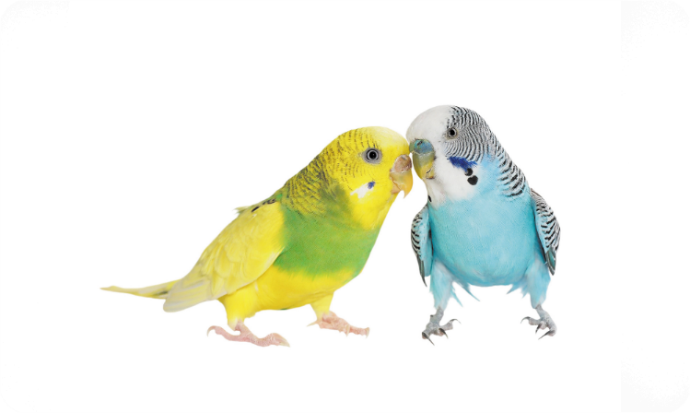
parrot
parrots
/ˈpær.ət/
/ˈpær.əts/
con vẹt
những con vẹt

Slide 11
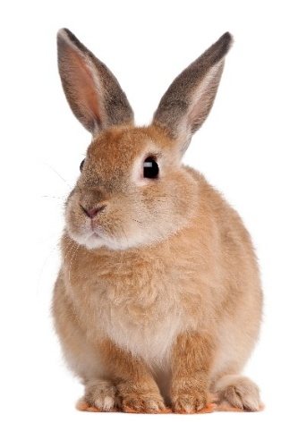
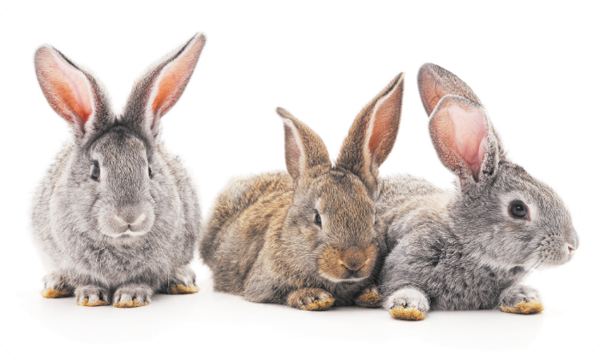
rabbit
rabbits
/ˈræb.ɪt/
/ˈræb.ɪts/
con thỏ
những con thỏ

Slide 12
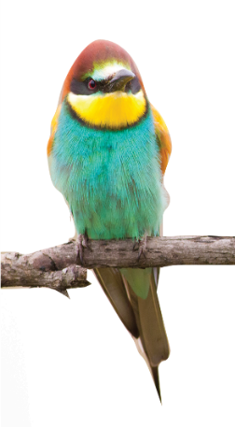
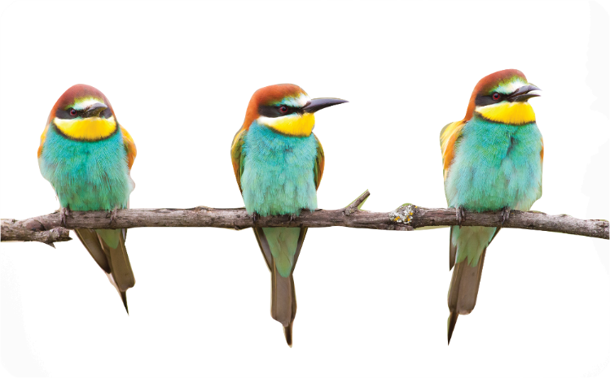
bird
birds
/bɜːd/
/bɜːdz/
con chim
những con chim

Slide 13
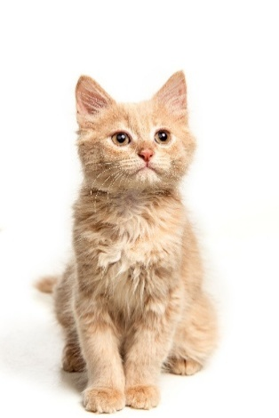
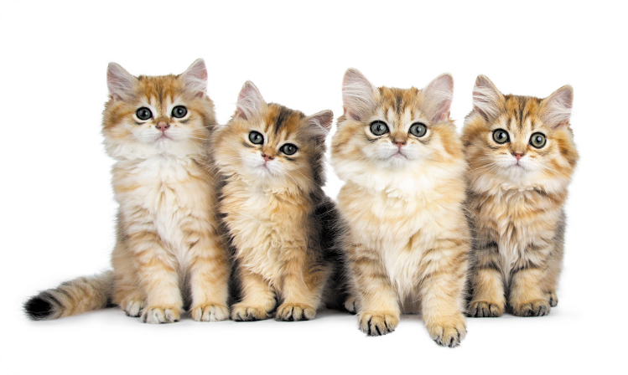
cat
cats
/kæt/
/kæts/
con mèo
những con mèo

Slide 14

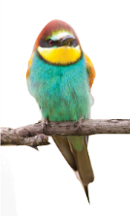
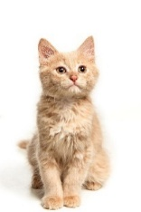


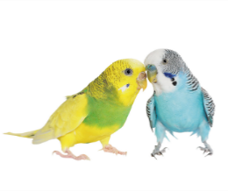

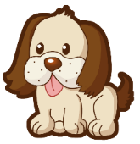

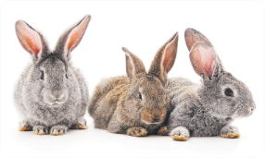
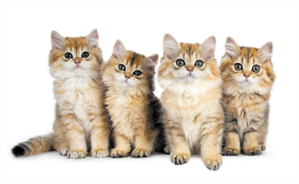
Review
dog
parrot
rabbit
bird
cat
dogs
parrots
rabbits
birds
cats

Slide 15





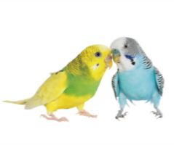



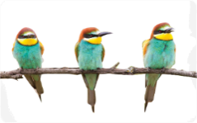
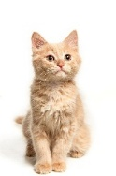
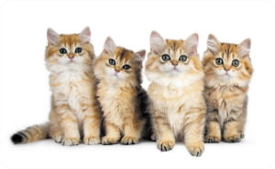
Vocabulary
1. pets
: các con thú cưng
2. dog
dogs
3. parrot
parrots
4. rabbit
rabbits
5. bird
birds
6. cat
cats

Slide 16



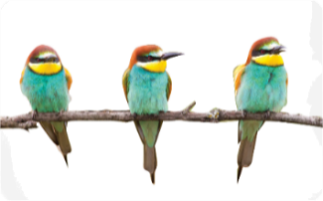


Match
1
2
3
4
5
6
pets
dogs
rabbit
parrot
cats
birds
a
b
c
d
e
f

Slide 17







2. Listen, point and say.
a
b
Do you have any _____?
birds / yes
parrots / no
Yes, I do.
c
d
No, I don’t.
rabbits / yes
cats / no
don’t = do not

Slide 18



2. Listen, point and say.
Do you have any _____?
a
Yes, I do.
No, I don’t.
birds / yes
Do you have any birds?
Yes, I do.
Click on the sentences to listen again.

Slide 19
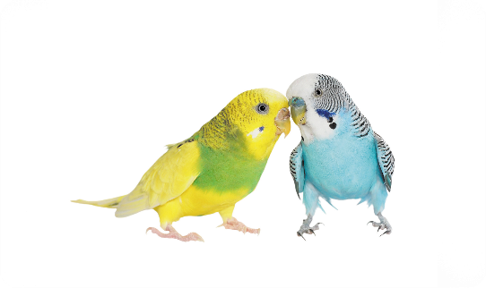


2. Listen, point and say.
Do you have any _____?
b
Yes, I do.
No, I don’t.
parrots / no
Do you have any parrots?
No, I don’t.

Slide 20



2. Listen, point and say.
c
Do you have any _____?
Yes, I do.
No, I don’t.
rabbits / yes
Do you have any rabbits?
Yes, I do.

Slide 21


2. Listen, point and say.
d
Do you have any _____?
Yes, I do.
No, I don’t.
cats / no
Do you have any cats?
No, I don’t.

Slide 22


Structures
Cách hỏi bạn có loại thú cưng nào không.
I have a dog.
Do you have any dogs?
Yes, I do.
- Do you have any _____?
+ Yes, I do.
+ No, I don’t.

Slide 23
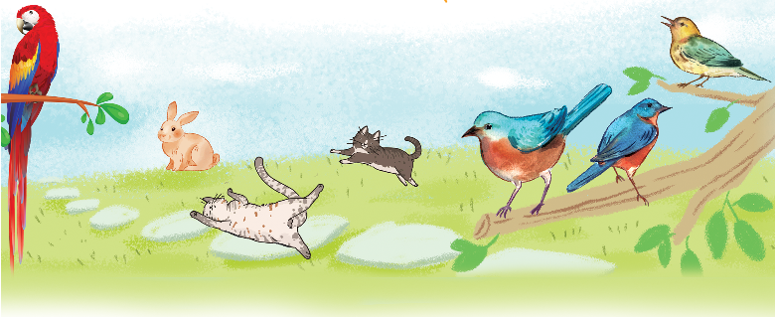
3. Let’s talk.
Do you have any ______?
Yes, / No, _____.

Slide 24

3. Let’s talk.
Do you have any ______?
parrots
__________.
No, I don’t

Slide 25
3. Let’s talk.
3. Let’s talk.
Do you have any ______?
rabbits
__________.
No, I don’t

Slide 26

3. Let’s talk.
Do you have any ______?
cats
__________.
Yes, I do

Slide 27
3. Let’s talk.
Do you have any ______?
birds
__________.
Yes, I do

Slide 28


Let’s play!
START

Slide 29

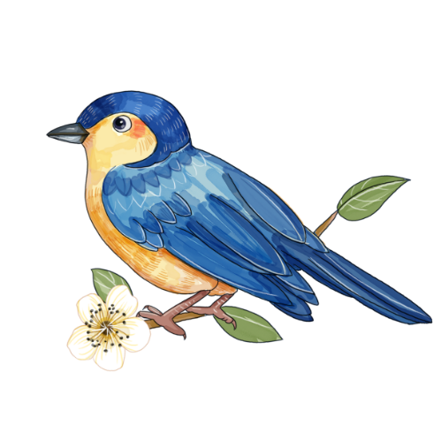

Choose the correct answer.
A. birds
B. bird
C. rabbit
NEXT

Slide 30
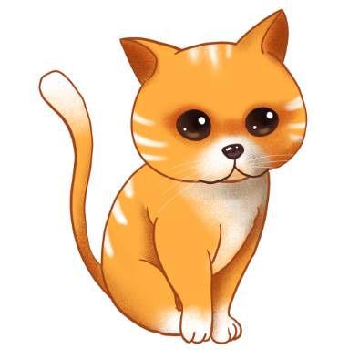
A. cat
B. rabbit
C. bird
NEXT

Slide 31
A. cat
B. birds
C. pets
NEXT

Slide 32
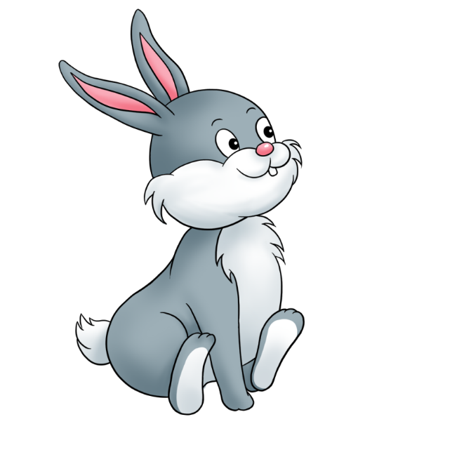


A. cat
B. rabbit
C. bird
NEXT

Slide 33



Linh: Do you have any dogs?
Mary: ________, I have two cats.
A. Yes, I do.
B. No, I don’t.
NEXT

Slide 34
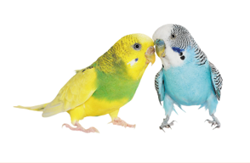
Do you have any _____?
A. parrot
B. parrots
C. rabbits
NEXT

Slide 35
Do you have any _____?
A. dogs
B. rabbits
C. birds
NEXT

Slide 36

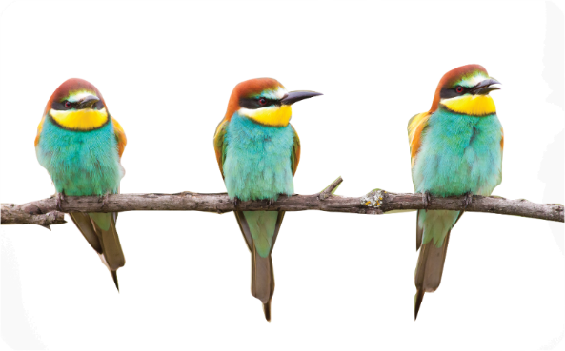
Nam: Do you have any birds?
Minh: ________.
A. Yes, I do.
B. No, I don’t.
NEXT

Slide 37
Minh: Do you have any parrots?
Mai: No, I ______.
A. do
B. don’t
NEXT

Slide 38

____ you have any rabbits?
A. Does
B. Do

Slide 39

Well done!

Slide 40
Homelink
Learn by heart all the new words
and the model sentences.
Read again the dialogues in part 1.

Slide 41

Thank you!

