Slide 1

Unit 8 : Transportation
Lesson 2.2: Phonics
Page: 55

Slide 2
Lesson Outline
Warm-up
Practice
Production
Consolidation
Wrap-up

Slide 3
Objectives
By the end of this lesson, students will be able to recognize the /ks/ and /j/ sounds.
Vocabulary: fox, box, yo-yo, yogurt
Phonics: /ks/, /j/

Slide 4

WARM UP

Slide 5
Let’s sing!

Slide 6


Alphabet song

Slide 7

It’s time to learn …

Slide 8

Phonics
/ks/,
/j/,

Slide 9


Click on the icon to hear the sound.
Y, y
/ j /

Slide 10
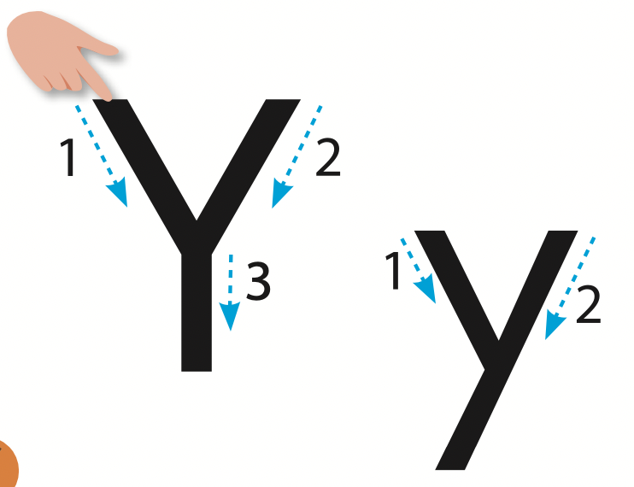
Let’s trace!

Slide 11

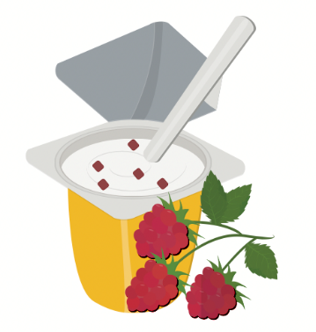

Click on the icon to hear the sound.
yogurt
Yo-yo
/j/
/j/

Slide 12
Click on the picture to hear the sound.
Yo-yo
/j/

Slide 13

Click on the picture to hear the sound.
yogurt
/j/

Slide 14


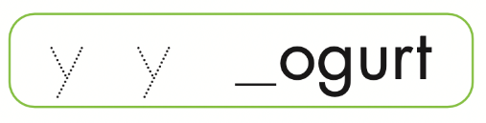
Let’s write!

Slide 15

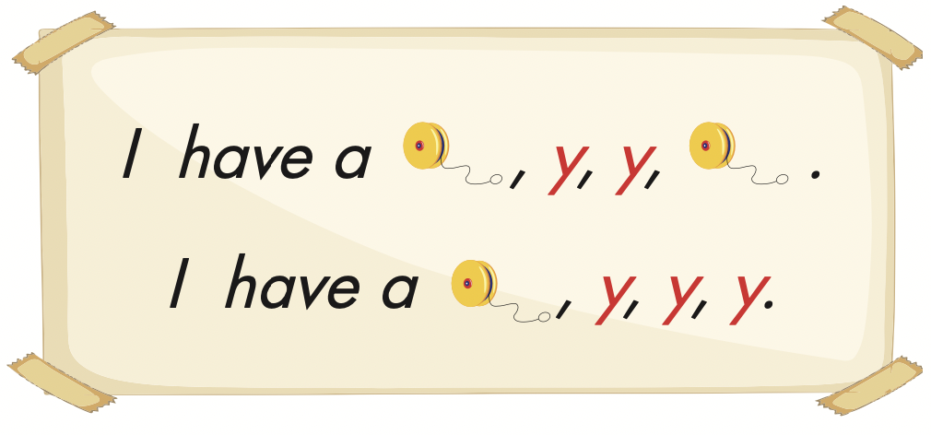
Click on the icon to hear the sound.

Slide 16
Let’s play!

Slide 17
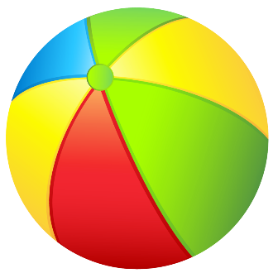
Pass the Ball Game
Pass the ball. When the music stops – who has the ball must answer the question
Notes:
Find the conversation question sheets (on many topics!) by clicking the Pass the Paper picture!

Slide 18

Pass the Ball Game

Slide 19
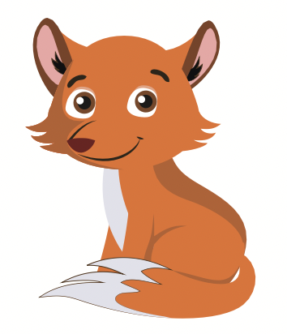
What is it?
CHECK

Slide 20
Pass the Ball Game

Slide 21

What is it?
CHECK

Slide 22
Pass the Ball Game

Slide 23
What is it?
/j/
CHECK

Slide 24
Pass the Ball Game

Slide 25
What is it?
CHECK

Slide 26
Pass the Ball Game

Slide 27
What is it?
CHECK

Slide 28
Pass the Ball Game

Slide 29
What is it?
Y
CHECK

Slide 30
Pass the Ball Game

Slide 31
What is it?
X
CHECK

Slide 32
Pass the Ball Game

Slide 33
What is it?
/ks/
CHECK

Slide 34


Slide 35

Production

Slide 36


Click on the icon to hear the sound.

Slide 37
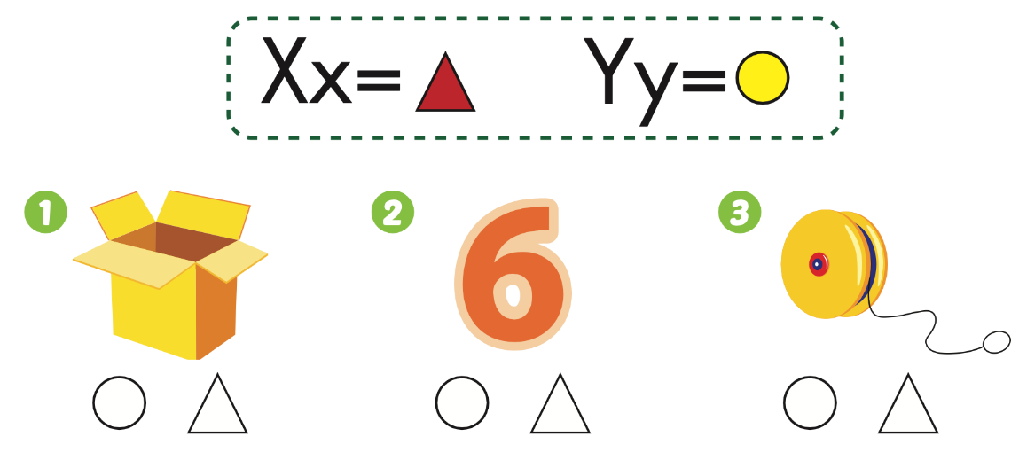
Extra Practice
WB, page 52

Slide 38

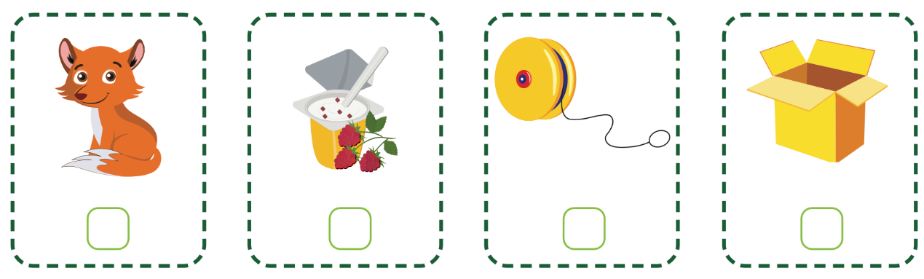
Extra Practice
WB, page 53
Click on the icon to hear the sound.
4
2
3
1

Slide 39
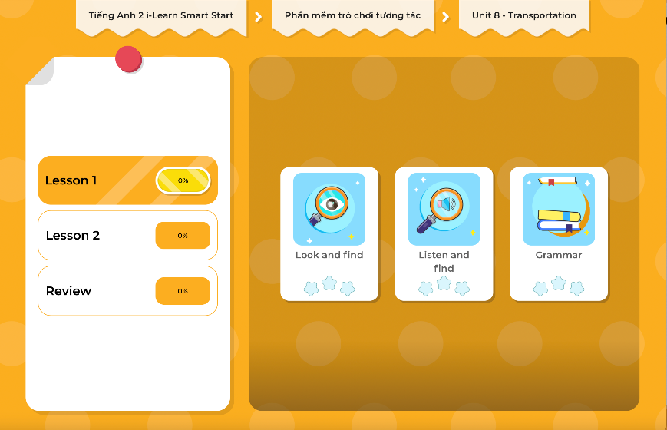
Extra Practice
DHA on Eduhome
LET’S PLAY!
Click on the picture below to play the games.

Slide 40

CONSOLIDATION

Slide 41

Let’s play!
Magic finger
Notes:
Divide the class into pairs.
Have student A write a word with their finger on student B’s back.
Have the student B guess which letter it is.

Slide 42

WRAP-UP

Slide 43
Lesson 3
Today’s lesson
Vocabularies
box,
fox,
yoyo,
yogurt
Phonics
/ks/, /j/

Slide 44
Lesson 3
Homework
Practice the vocabularies and structure; and make sentences using them.
Do the exercises in Tiếng Anh 2 i-Learn Smart Start WB (pages 52, 53)
Do the exercises in Tiếng Anh 2 i-Learn Smart Start Notebook (page 55)
Prepare the next lesson (page 56 SB)
Play the consolidation games in Tiếng Anh 2 i-Learn Smart Start DHA App on www.eduhome.com.vn

Slide 45

Enjoy your day!

Slide 46

Have a nice day!

