Slide 1

Unit 9: Toys
Lesson 1.1: Vocabulary & Sentence Patterns
Page: 56

Slide 2
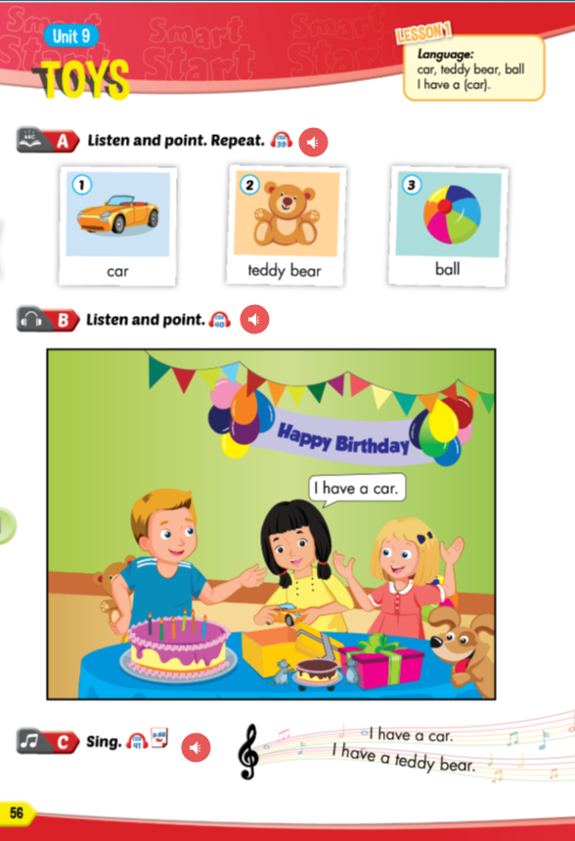
Lesson Outline
Warm-up
Vocabulary
Structure
Practice
Consolidation
Wrap-up

Slide 3
Objectives
By the end of this lesson, students will be able to identify and use vocabulary for toys, using ….
Vocabulary:
car, teddy bear, ball
Sentence pattern:
I have a (car).

Slide 4

WARM UP

Slide 5

What is it?
banana
Notes:
click to open a new question

Slide 6
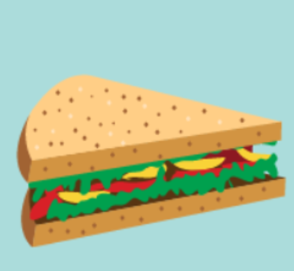
What is it?
sandwich

Slide 7

What is it?
cookie

Slide 8
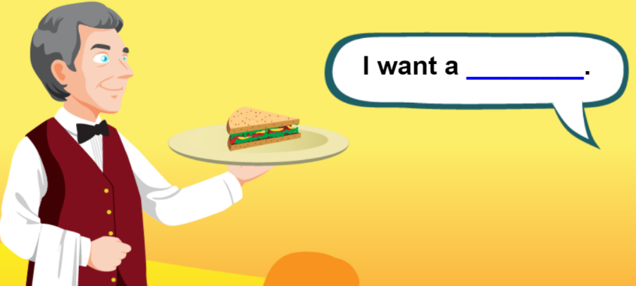
sandwich

Slide 9
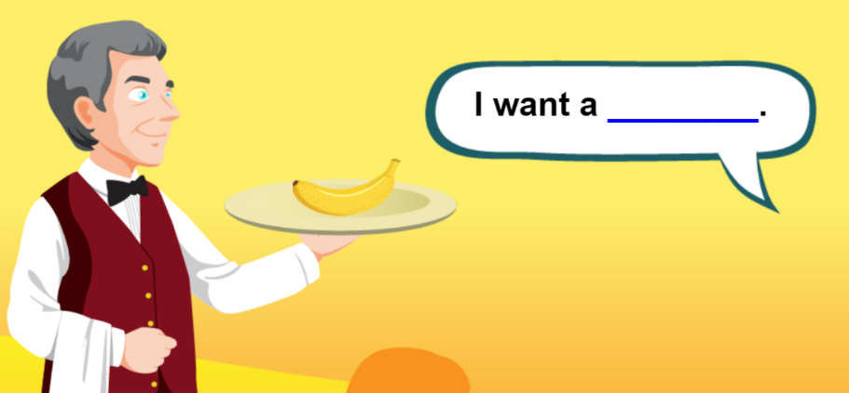
banana

Slide 10
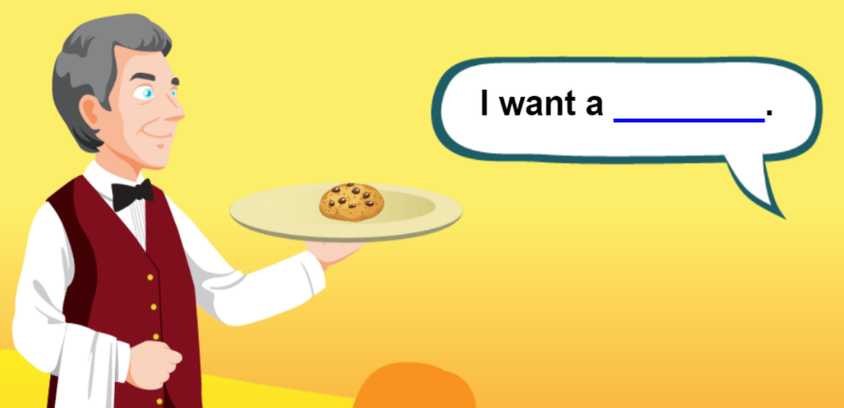
I ___ a cookie
want

Slide 11
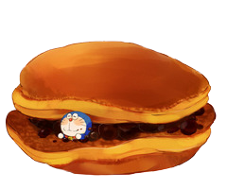
GOOD JOB !
END

Slide 12

It’s time to learn …

Slide 13
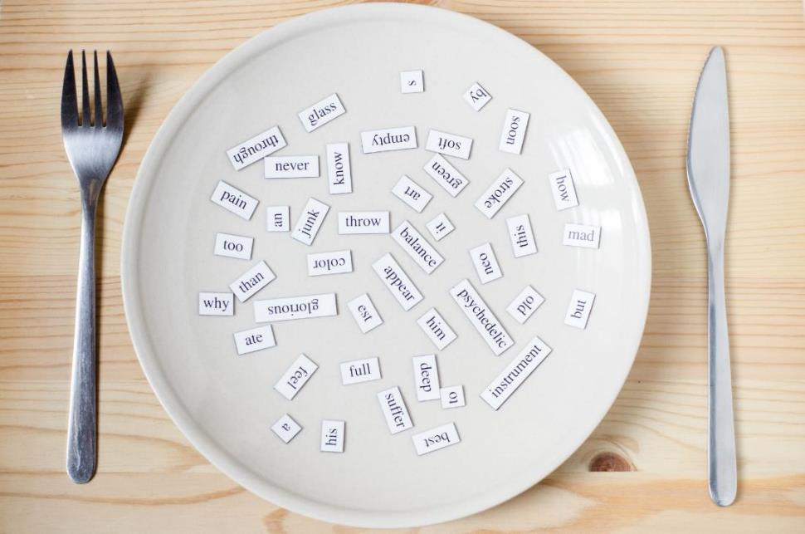
New words
car, teddy bear, ball

Slide 14


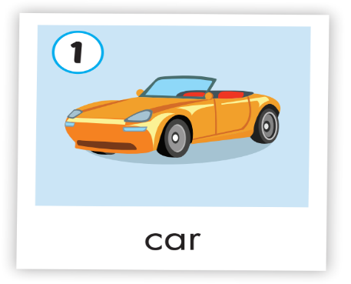
Click on picture to hear the sound
/kɑːr/
xe hơi
Notes:
Click vào hình A. 1. Listen and point. Repeat để cho cả audio full chạy

Slide 15

Click on picture to hear the sound
/ˈtedi beə(r)/
gấu bông
Notes:
Click vào hình A. 1. Listen and point. Repeat để cho cả audio full chạy

Slide 16
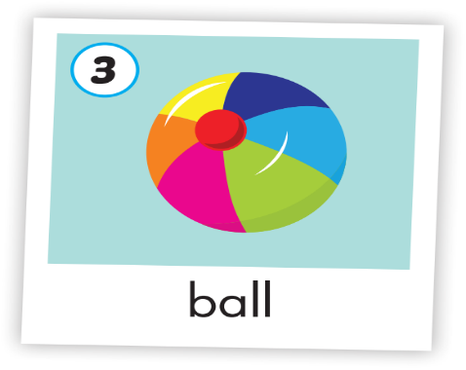
Click on picture to hear the sound
/bɔːl /
quả bóng
Notes:
Click vào hình A. 1. Listen and point. Repeat để cho cả audio full chạy

Slide 17



Click on picture to hear the sound
/kɑːr/
xe hơi
/ˈtedi beə(r)/
gấu bông
/bɔːl /
quả bóng
Notes:
Click vào hình A. 1. Listen and point. Repeat để cho cả audio full chạy

Slide 18

Structures
I have a (car).

Slide 19
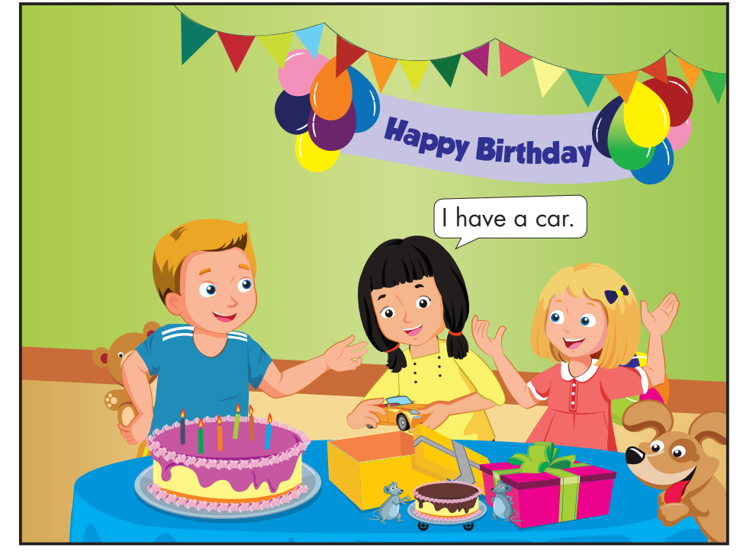
Click on picture to hear the sound
I have a teddy bear.
I have a ball.
Notes:
Click on the space to move the next sentence.

Slide 20

Practice

Slide 21


Click on picture to hear the sound
I have a car.
I have a car.
I have a teddy bear.
I have a teddy bear.
I have a ball.
I have a ball.
I have a car.
I have a car.
I have a teddy bear.
I have a teddy bear.
I have a ball.
I have a ball.
Notes:
GV click lần 1 để follow lyric 1
Gv click lần 2 để follow lyric 2

Slide 22

Further Practice

Slide 23
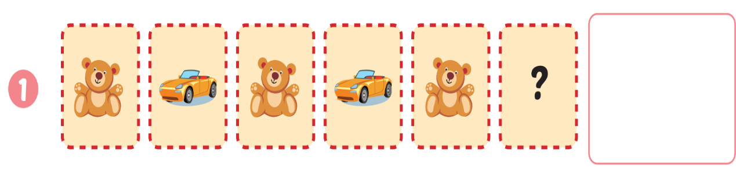

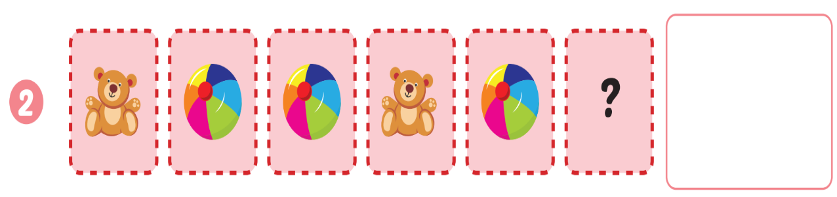

Extra Practice
WB, page 54.
Click on the square to show the answer

Slide 24
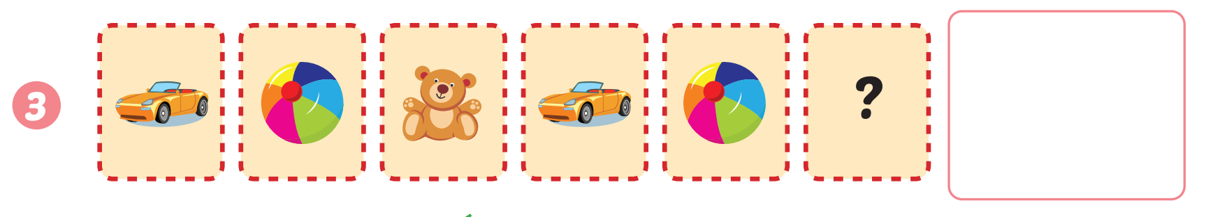
Extra Practice
WB, page 54.
Click on the square to show the answer

Slide 25

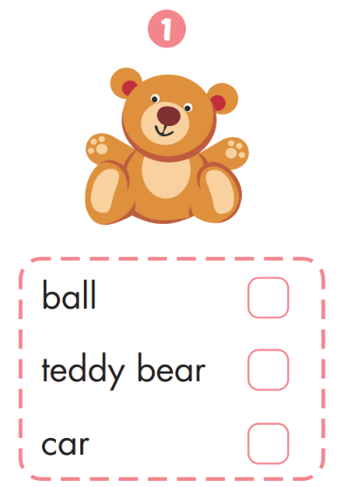
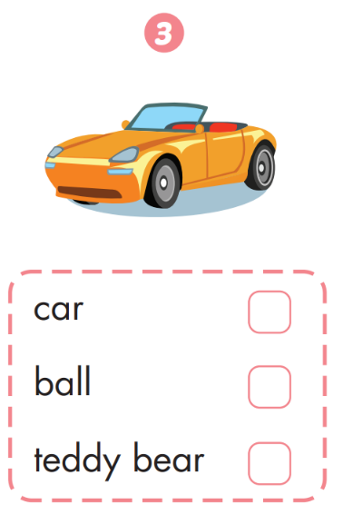
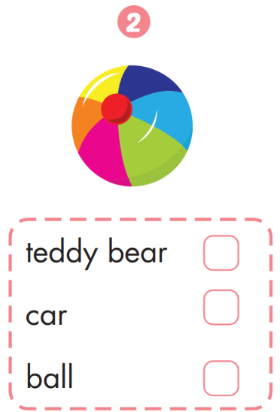
Extra Practice
WB, page 54.
✔️
✔️
✔️

Slide 26
It’s time to play …

Slide 27







1
2
3
4
5
6
7
8
Click on the square to see the picture
Click on to close the picture.
Notes:
Memory game. GV nhấn vào ô để mở, nếu HS chọn 2 hình không giống nhau, GV nhấn vào hình tròn để đóng hình lại, HS phải nhớ những hình đã mở.

Slide 28

CONSOLIDATION

Slide 29
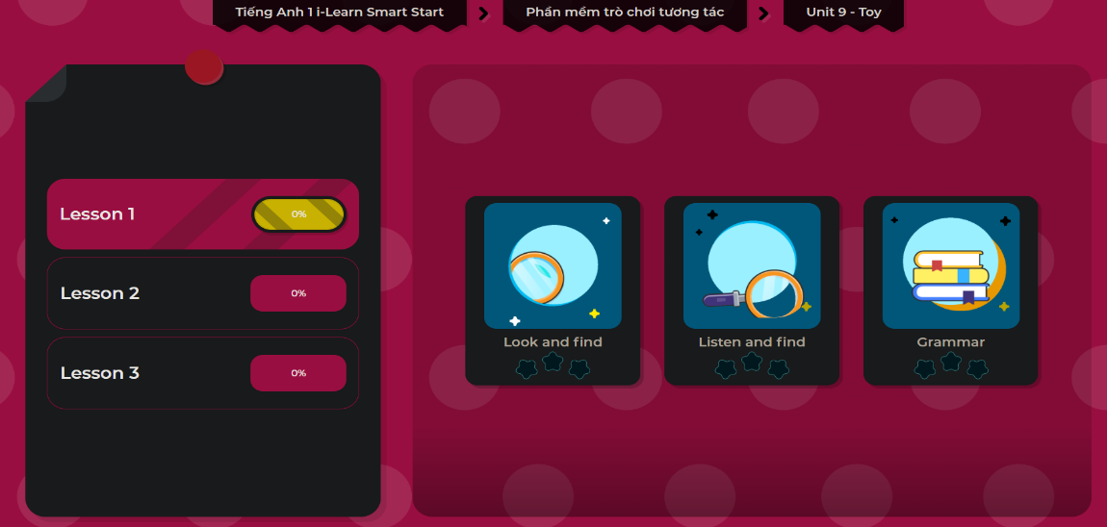
Extra Practice
DHA App
LET’S PLAY!

Slide 30
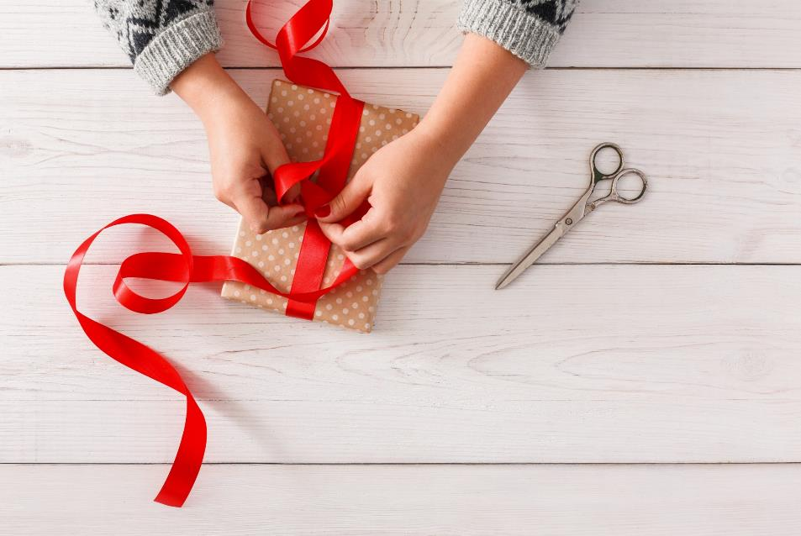
WRAP-UP

Slide 31
Today’s lesson
Vocabulary
car, teddy bear, ball
Structures/ Sentence patterns
I have a (car).

Slide 32
Homework
Practice vocabularies and structure. Make sentences using them.
Practice the vocabulary and structure in Tiếng Anh 1 i-Learn Smart Start Notebook (page 52)
Do the exercises in Tiếng Anh 1 i-Learn Smart Start Workbook (page 54)
Play the consolidation games in Tiếng Anh 1 i-Learn Smart Start DHA App on www.eduhome.com.vn
Prepare the next lesson (page 57)

Slide 33

Enjoy your day!

