Slide 1

Unit 9: Toys
Lesson 1.2: Vocabulary & Sentence Patterns
Page: 57

Slide 2
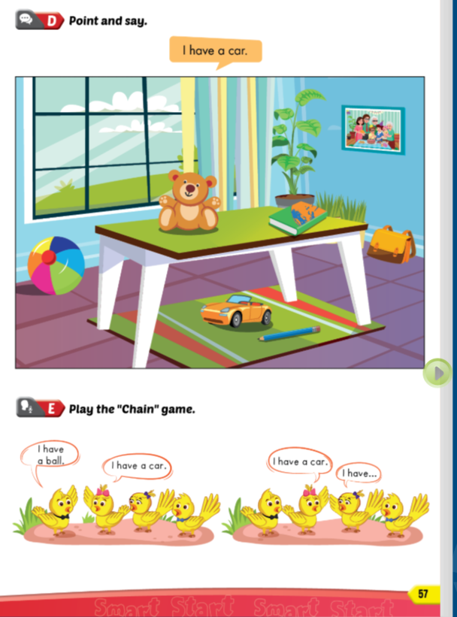
Lesson Outline
Warm-up
Speaking
Practice
Consolidation
Wrap-up

Slide 3
Objectives
By the end of this lesson, students will be able to say the names of toys, using …..
Vocabulary:
car, teddy bear, ball
Sentence pattern:
I have a (car).

Slide 4

WARM UP

Slide 5
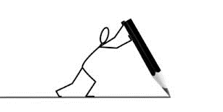
Draw a line

Slide 6
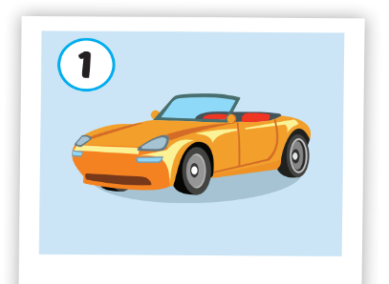
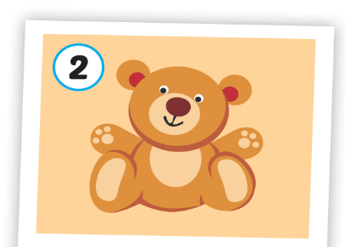
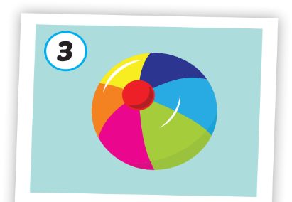
teddy bear
ball
car

Slide 7

It’s time to learn …

Slide 8

Speaking

Slide 9

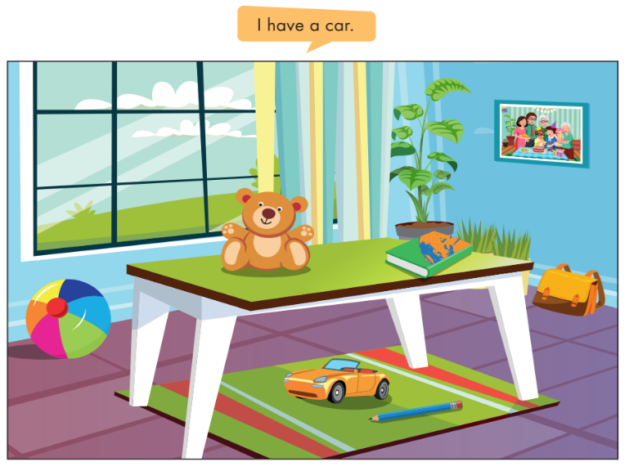
Divide the class into pairs.
Have Student A point to the picture and Student B say, e.g. "I have a car.“
Swap roles and repeat.
Afterwards, have some pairs demonstrate the activity in front of the class.

Slide 10

Practice

Slide 11

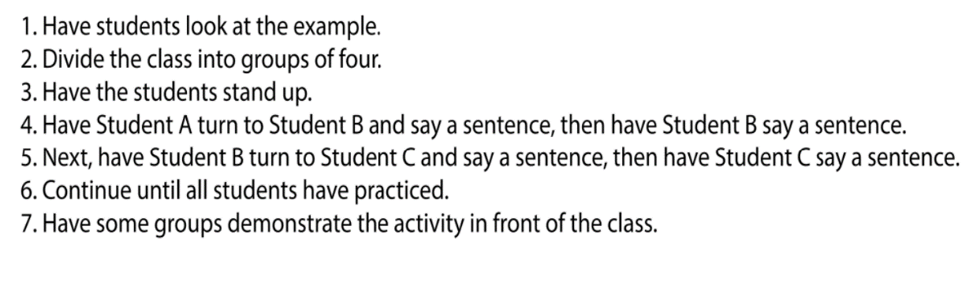

Slide 12
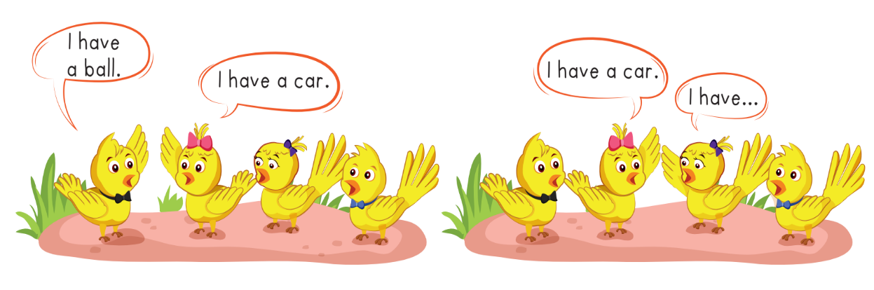

Slide 13
Further Practice

Slide 14


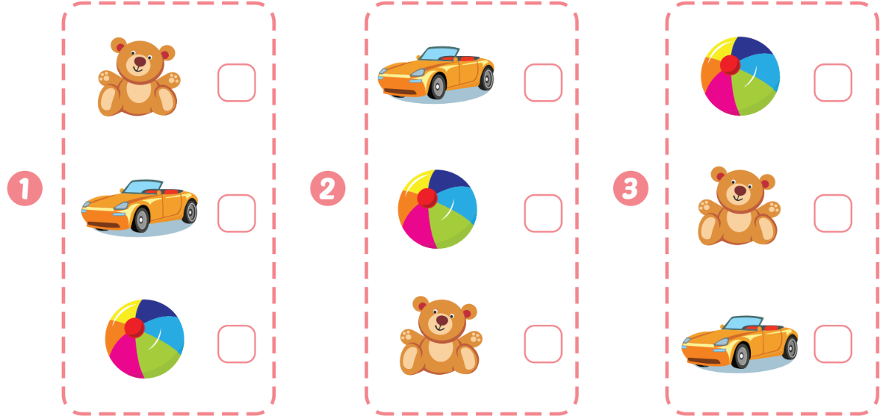
Extra Practice
WB, page 55.
Click on the number to hear the sound
✔️
✔️
✔️
1
2
3

Slide 15

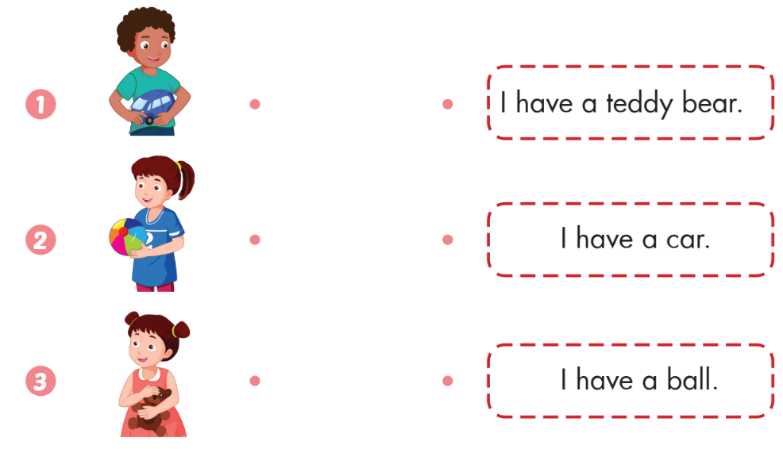
Extra Practice
WB, page 55.

Slide 16
It’s time to play …

Slide 17



Slide 18


Divide students into 2 teams.
Each team takes turns answering the question.
If you answer 1 question correctly, you will get 1 point.
The winning team is the team with the most points.
START

Slide 19

1
2
3
4
5
6
7
8
END

Slide 20



b_ar
a bear

Slide 21

What is it?
a ball

Slide 22

a car/ I/ have
I have a car.

Slide 23

I ___a___
I have a ball.

Slide 24

rca
a car

Slide 25

I have a ____
I have a teddy bear.

Slide 26


Slide 28


Slide 30

CONSOLIDATION

Slide 31
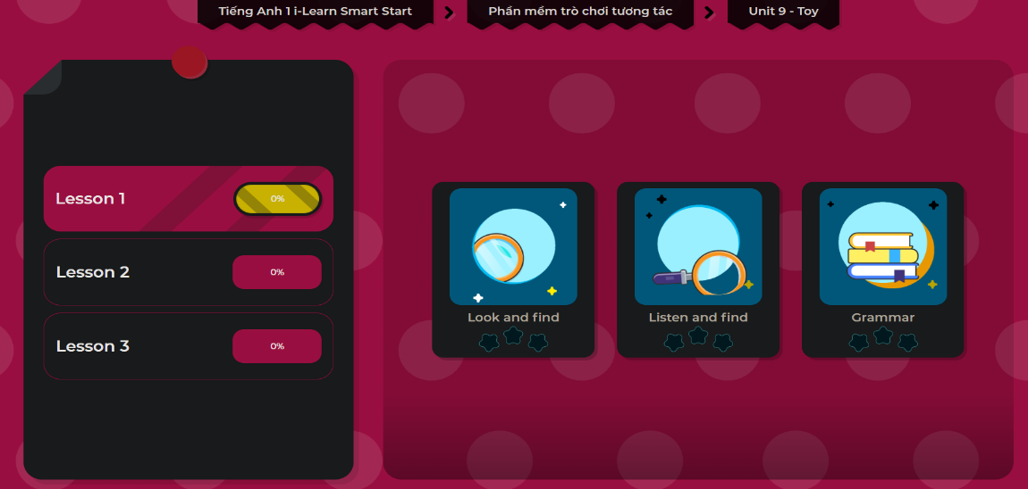
Extra Practice
DHA App
LET’S PLAY!

Slide 32

WRAP-UP

Slide 33
Today’s lesson
Structures/ Sentence patterns
I have a (car).
Vocabulary
car, teddy bear, ball

Slide 34
Homework
Review the vocabularies & structures and make sentences using them.
Practice the vocabulary and structure in Tiếng Anh 1 i-Learn Smart Start Notebook (page 53)
Do the exercises in Tiếng Anh 1 i-Learn Smart Start Workbook (page 55)
Play the consolidation games in Tiếng Anh 1 i-Learn Smart Start DHA App on www.eduhome.com.vn
Prepare the next lesson (page 58)

Slide 35

Enjoy your day!

