Slide 1

Unit 9: Toys
Lesson 2.1: Vocabulary & Phonics
Page: 58

Slide 2
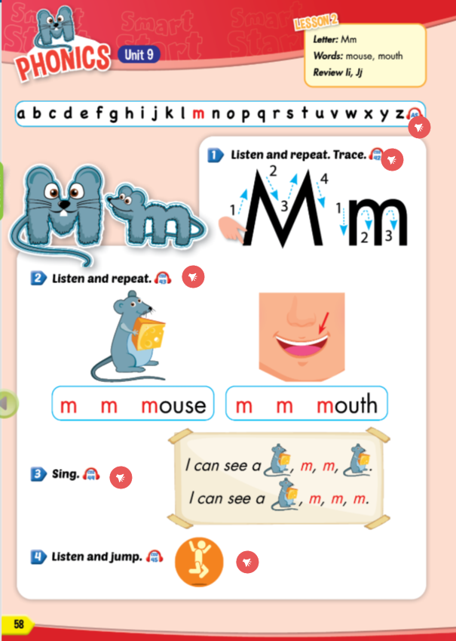
Lesson Outline
Warm-up
Phonics
Practice
Consolidation
Wrap-up

Slide 3
Objectives
By the end of this lesson, students will be able to recognize the letter M/m; make the /m/ sound.
Phonics:
/m/
Vocabulary:
mouse, mouth

Slide 4

WARM UP

Slide 5
THE SLAP GAME 🙌🏽

Slide 6
Xe hơi
a car
a cat

Slide 7
Tôi có một con gấu bông.
I have a teddy bear.
I have a car.

Slide 8
quả bóng
a car
a ball

Slide 9
gấu bông
a teddy bear
a ball

Slide 10
Tôi có một quả bóng
I have a car.
I have a ball.

Slide 11

It’s time to learn …

Slide 12

Phonics
/m/

Slide 13


📢
Click the speaker to hear the sound!

Slide 14

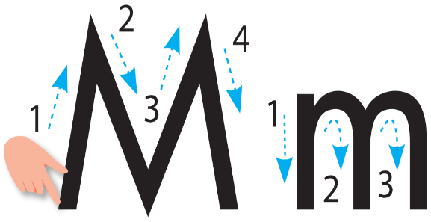
Click on the textbook to hear the sound.
Notes:
Click vào hình A. 1. Listen and point. Repeat để cho cả audio full chạy

Slide 15


Click on the picture to hear the sound
/maʊs/
Con chuột

Slide 16
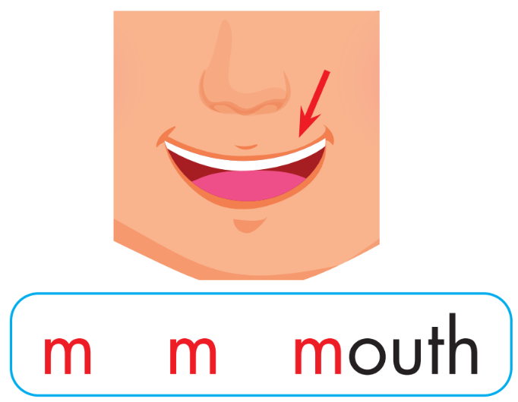
Click on the picture to hear the sound
/maʊθ/
miệng

Slide 17

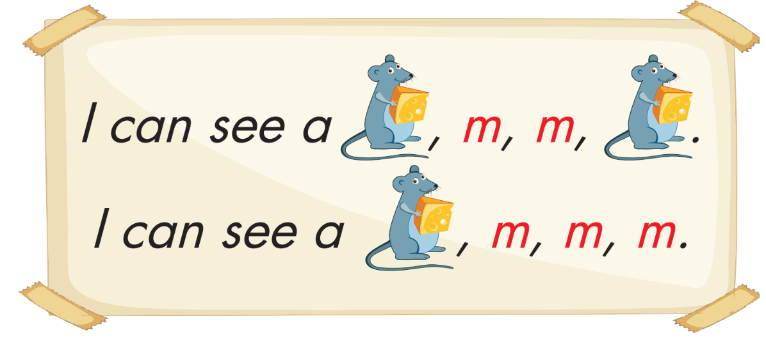
Click on the picture to hear the sound

Slide 18



Click on the ciclre to hear the sound
Demonstrate the activity.
Have students stand up.
Have students jump when they hear the /m/ sound.

Slide 19

Practice

Slide 20
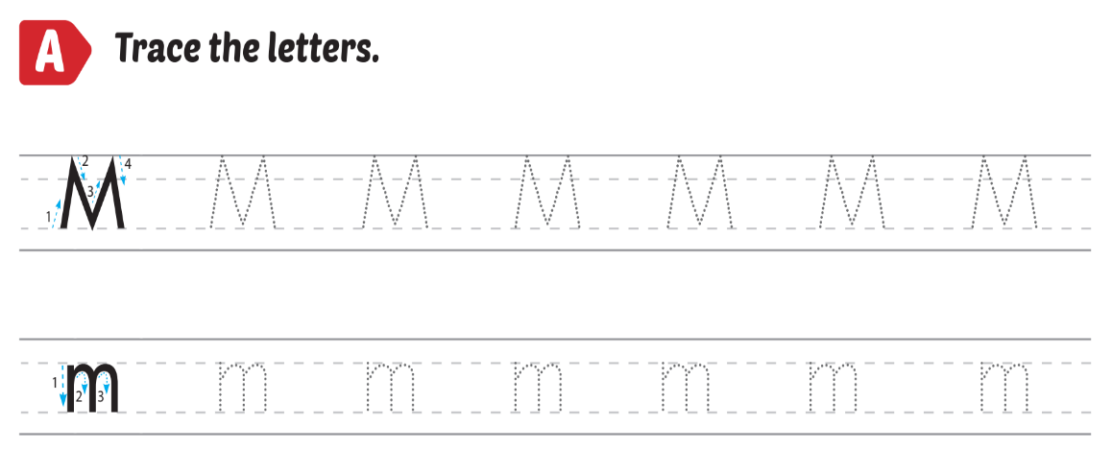
Extra Practice
WB, page 56.

Slide 21

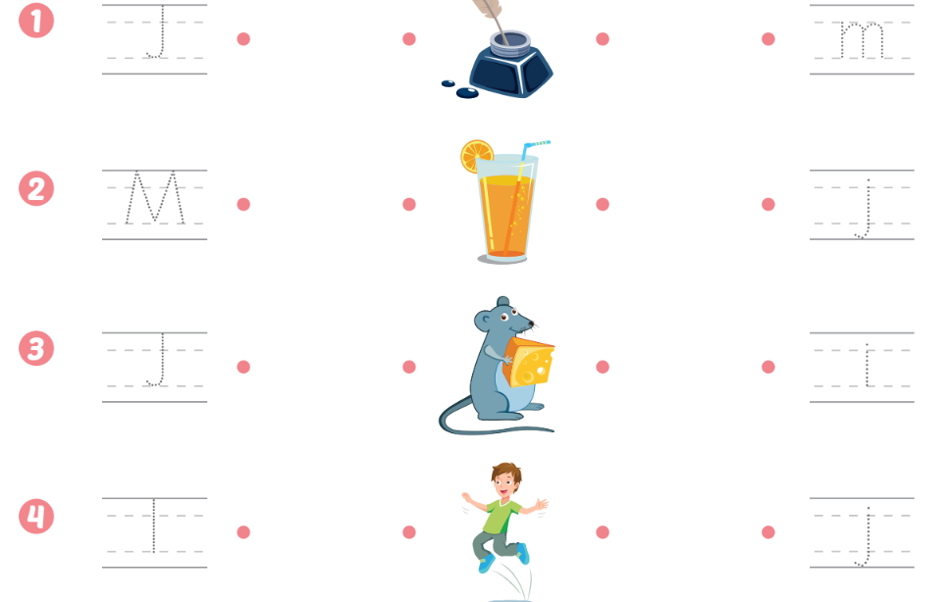

Slide 22

Further Practice

Slide 23

Funtime
Let's draw a mouse
Let’s draw a mouse
Each student shows his/her picture to everyone and says:
“‘m’, ‘m’, mouse’’
Someone who doesn't do it right, he/she will be punished.

Slide 24

CONSOLIDATION

Slide 25
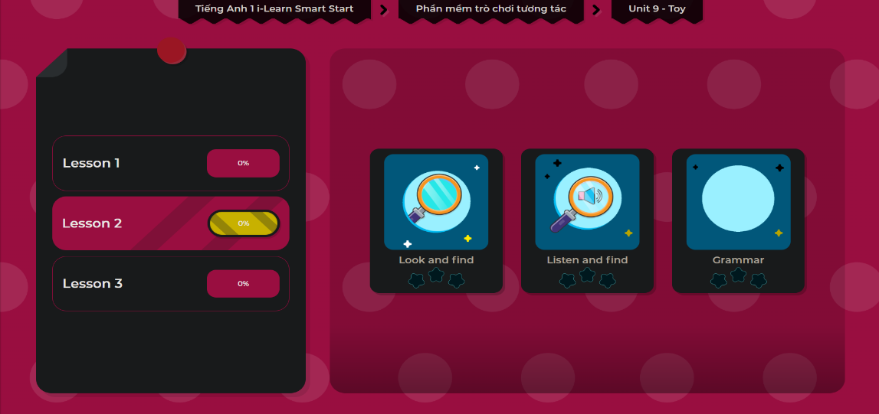
Extra Practice
DHA App
LET’S PLAY!

Slide 26

WRAP-UP

Slide 27
Today’s lesson
Phonics
/m/
Vocabulary
mouse, mouth

Slide 28
Homework
Practice vocabularies and phonics. Make sentences using them.
Practice the vocabulary and phonics in Tiếng Anh 1 i-Learn Smart Start Notebook (page 54)
Do the exercises in Tiếng Anh 1 i-Learn Smart Start Workbook (page 56)
Play the consolidation games in Tiếng Anh 1 i-Learn Smart Start DHA App on www.eduhome.com.vn
Prepare the next lesson (page 59)

Slide 29

Enjoy your day!

