Slide 1

Unit 9: Toys
Lesson 2.2: Vocabulary & Phonics
Page: 59

Slide 2
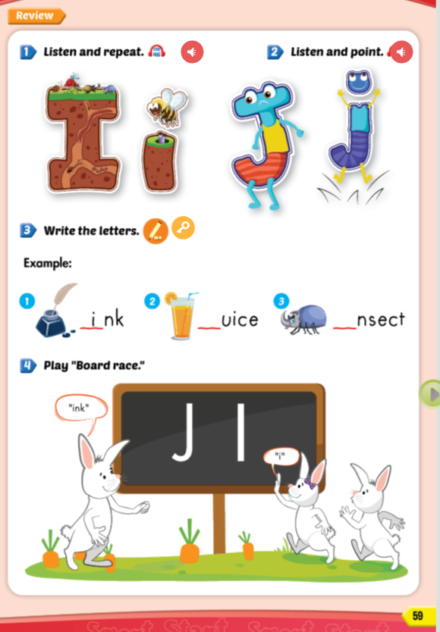
Lesson Outline
Warm-up
Phonics
Practice
Consolidation
Wrap-up

Slide 3
Objectives
By the end of this lesson, students will be able to recognize the letters I/i , J/j; make the I/i , J/j sounds and produce them individually.
Phonics:
Revise /i/ and /j/
Vocabulary:
Revise “ink”, “juice”, “insect”

Slide 4

WARM UP

Slide 5
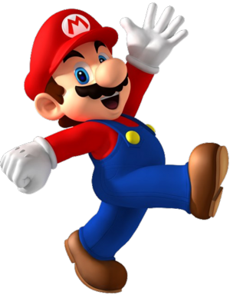
FUNTIME
Let’s draw a picture that starts with letters “i” or “j”
Each student shows his/her picture to everyone and read that word. (e.g. “‘i’, ‘i’, insect’’)
Someone who doesn't do it right, he/she will be punished.

Slide 6


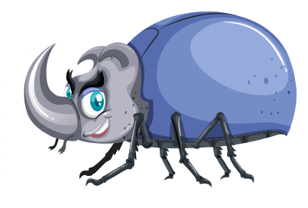
Draw a picture that starts with the letters “j” or “i”

Slide 7

It’s time to learn …

Slide 8

Phonics
/i/ and /j/

Slide 9


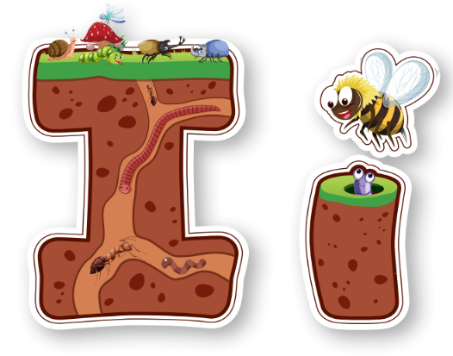
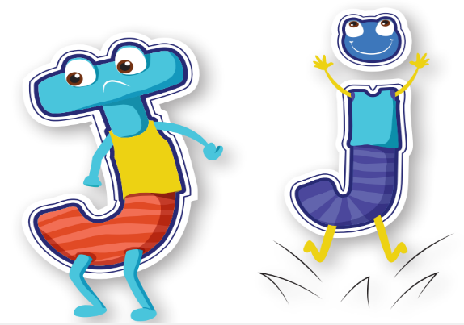
Notes:
Click vào hình A. 1. Listen and point. Repeat để cho cả audio full chạy

Slide 10







insect
juice
jump
ink
Click on the number to hear the sound
1
2
3
4

Slide 11

Practice

Slide 12

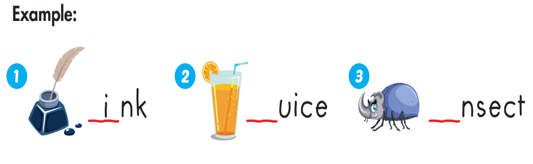
j
i

Slide 13

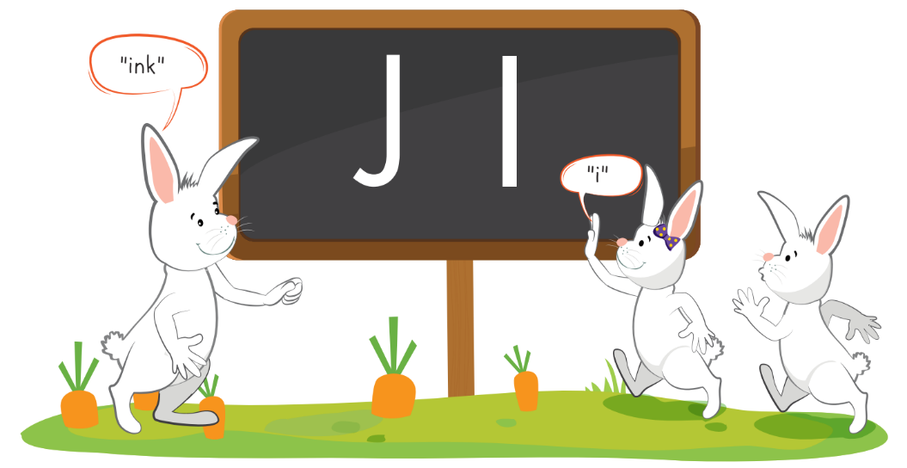
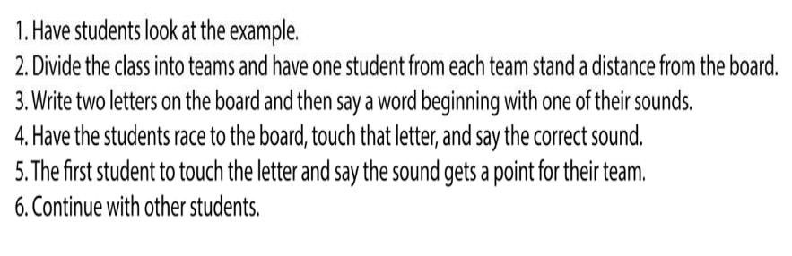

Slide 14

Further Practice

Slide 15

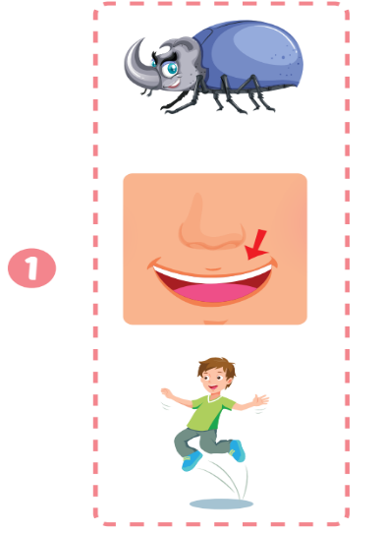
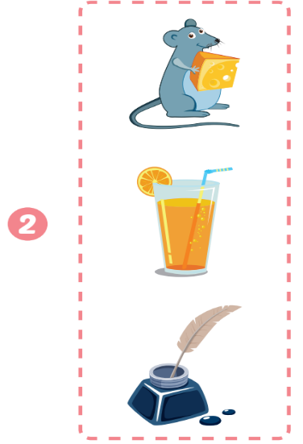
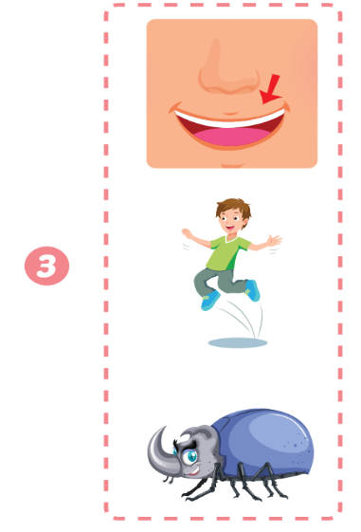
Extra Practice
WB, page 57.
Click on the picture to hear the sound
Click on the space to show answer
Notes:
Click on the picture to hear the sound
Click on the space to show answer

Slide 16

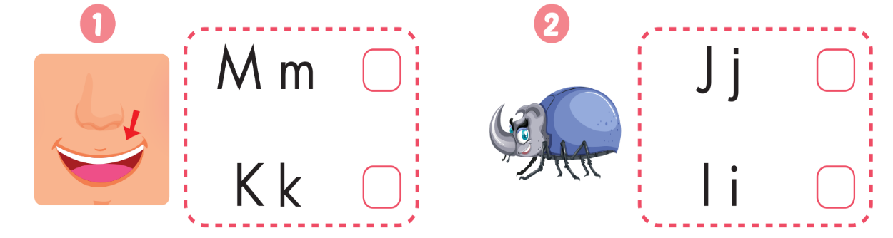
Extra Practice
WB, page 57.
✔️
✔️

Slide 17
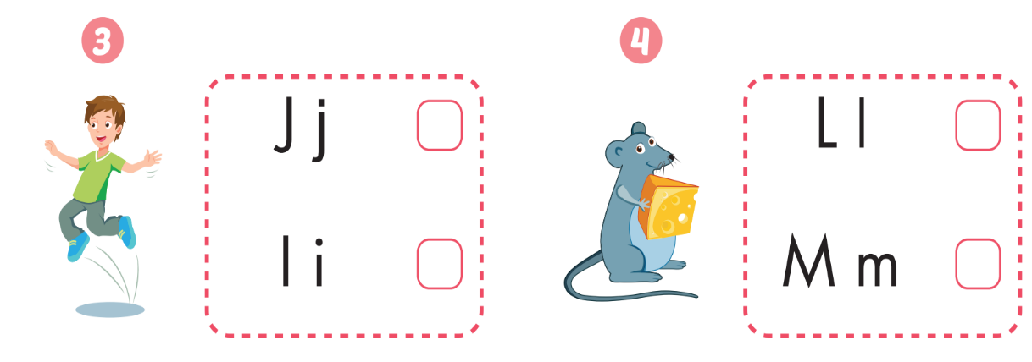
Extra Practice
WB, page 57.
✔️
✔️

Slide 18
It’s time to play …

Slide 19


Farm
construction

Slide 20








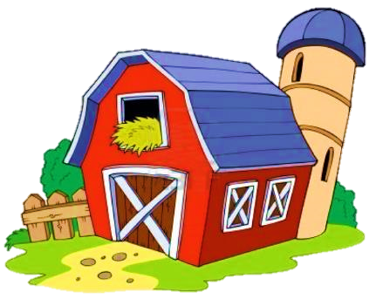








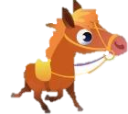


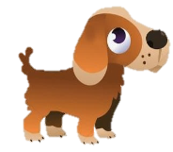


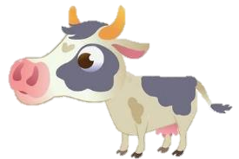


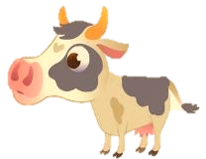
Click on the number to open the task
Click on the items
Yes or No
END
Notes:
HS chọn 1 ô số để mở
Sau khi HS trả lời câu hỏi, GV chọn vào mỗi item tương ứng

Slide 21



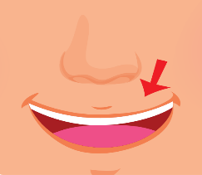
I/i is for
NO

Slide 22
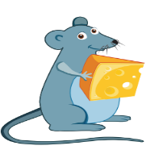
M/m is for
YES

Slide 23

I/i is for
YES

Slide 24

M/m is for
NO

Slide 25
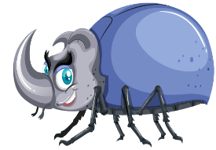
I/i is for
YES

Slide 26

J/j is for
YES

Slide 27

CONSOLIDATION

Slide 28
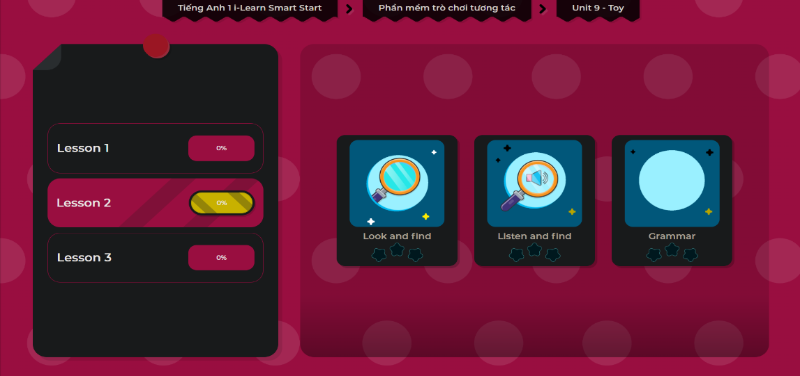
Extra Practice
DHA App
LET’S PLAY!

Slide 29

WRAP-UP

Slide 30
Today’s lesson
Phonics
Revise /i/ and /j/
Vocabulary
Revise “ink”, “juice”, “insect”

Slide 31
Homework
Practice vocabularies and phonics. Make sentences using them.
Practice the vocabulary and phonics in Tiếng Anh 1 i-Learn Smart Start Notebook (page 55)
Do the exercises in Tiếng Anh 1 i-Learn Smart Start Workbook (page 57)
Play the consolidation games in Tiếng Anh 1 i-Learn Smart Start DHA App on www.eduhome.com.vn
Prepare the next lesson (page 60)

Slide 32

Enjoy your day!

