Slide 1


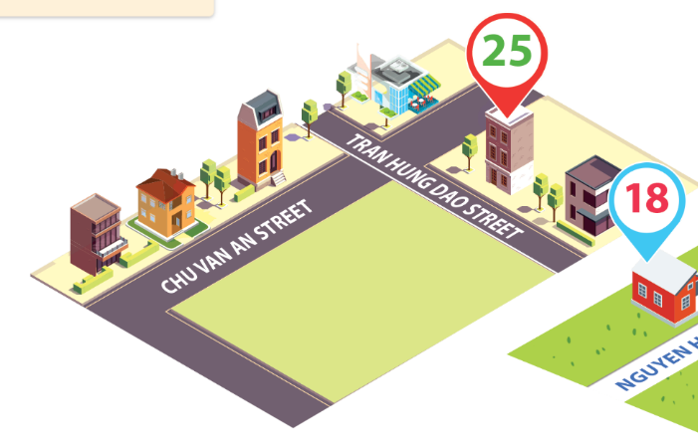
Monday, January 19th 2026
Unit
11
MY HOME
Lesson 1: 1, 2, 3

Slide 2
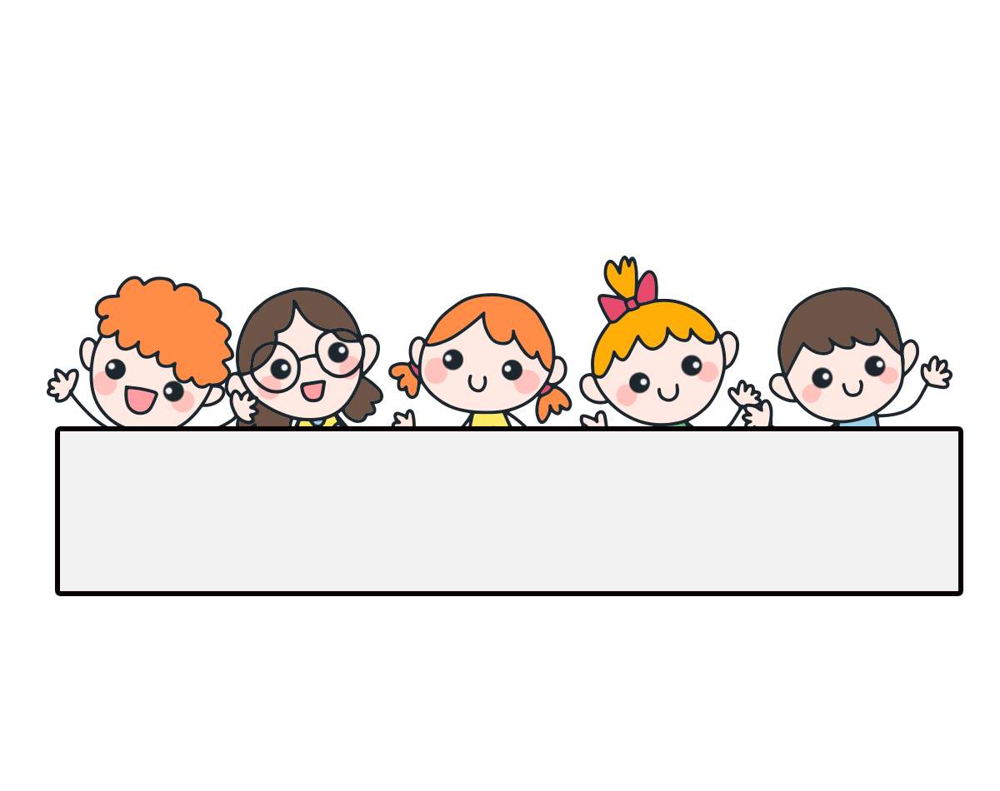
Warm-up

Slide 3
Let’s play the game

Slide 4


1. Look, listen and repeat.
My birthday party is on Sunday. Can you come to my party.
Where do you live?
a
b
Yes, I can.
I live in Tran Hung Dao Street.
What are they talking about?
Where are they?
Who are they?

Slide 5
Vocabulary

Slide 6
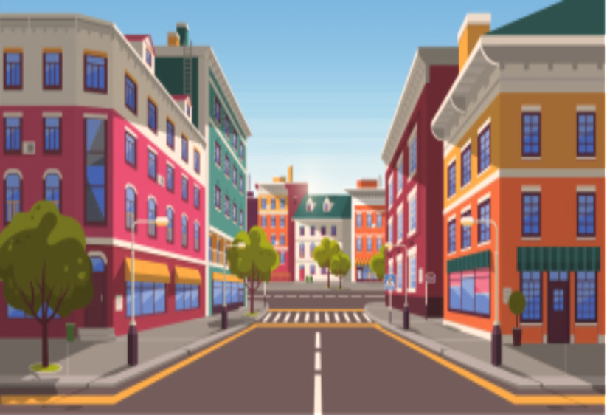
Vocabulary
street
/striːt/
phố, đường phố
Click on the sentences to listen again.

Slide 7
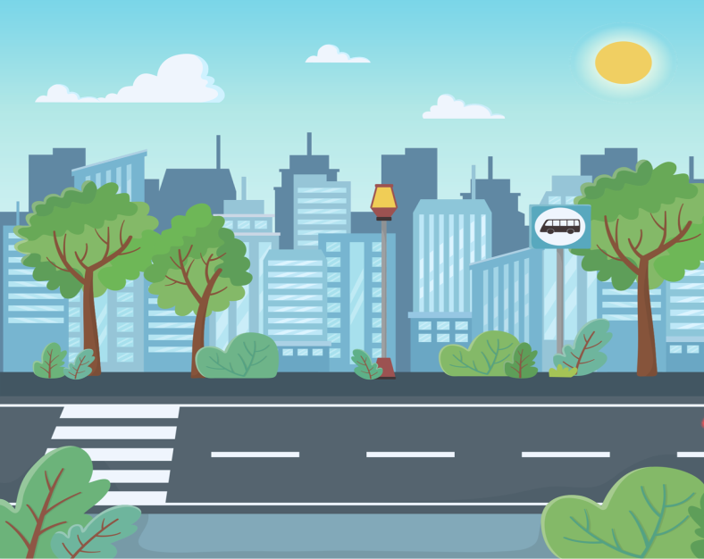
Vocabulary
road
/rəʊd/
con đường,
đường phố

Slide 8
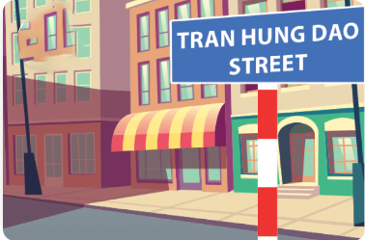
Vocabulary
in Tran Hung Dao Street
/ɪn Tran Hung Dao striːt/
ở phố Trần Hưng Đạo

Slide 9
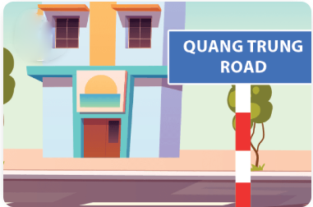
Vocabulary
in Quang Trung Road
/ɪn Quang Trung rəʊd/
ở đường Quang Trung

Slide 10
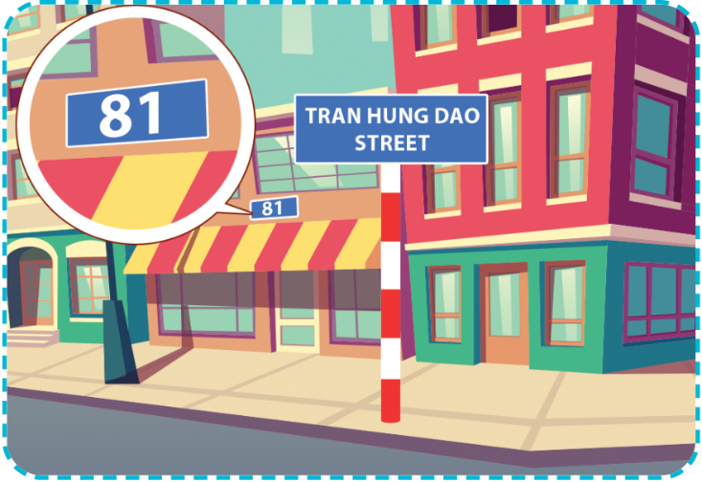
Vocabulary
at 81 Tran Hung Dao Street
/æt 81 Tran Hung Dao striːt/
ở số 81 phố Trần Hưng Đạo

Slide 11
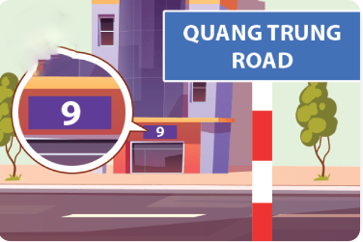
Vocabulary
at 9 Quang Trung Road
/æt 9 Quang Trung rəʊd/
ở số 9 đường Quang Trung

Slide 12
Vocabulary
live
/lɪv/
sống

Slide 13
Vocabulary
in (+ name of the road / street)
/ɪn/
trong, ở (đi cùng với tên đường / phố)
EX: in Tran Hung Dao Street
in Quang trung Road

Slide 14
Vocabulary
at (+ house number)
/æt/
ở, tại ( đi cùng với số nhà)
EX: at 81 Tran Hung Dao Street
at 9 Quang trung Road

Slide 15


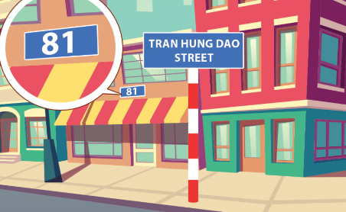
Review
street
road
in Tran Hung Dao Street
in Quang Trung Road
at 81 Tran Hung Dao Street
at 9 Quang Trung
Road
live
in
at

Slide 16
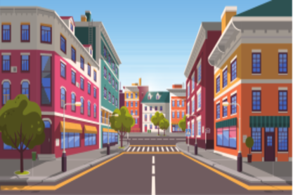


Complete and say.
street
road
in
at
street
road
in
at
1
2
3
__ Tran Hung Dao Street
street
road
in
_____
_____
4
5
6
at
at
in
__ 81 Tran Hung Dao Street
__ 9 Quang Trung Road
__ Quang Trung Road

Slide 17
Vocabulary
1. street
phố, đường phố
2. road
con đường, đường phố
3. in Tran Hung Dao Street
ở phố Trần Hưng Đạo
4. in Quang Trung Road
ở đường Quang Trung
5. at 81 Tran Hung Dao Street
ở số 81 phố Trần Hưng Đạo
6. at 9 Quang Trung Road
ở số 9 đường Quang Trung
7. live
sống
8. in (+ name of the road / street)
trong, ở
9. at ( + house number)
ở, tại

Slide 18

2. Listen, point and say.
a
b
Where do you live?
in Tran Hung Dao Street
in Quang Trung Road
I live ________.
c
d
at 81 Tran Hung Dao Street
at 9 Quang Trung Road

Slide 19


2. Listen, point and say.
a
in Tran Hung Dao Street
Where do you live?
I live in Tran Hung Dao Street.

Slide 20
2. Listen, point and say.
b
in Quang Trung Road
Where do you live?
I live in Quang Trung Road.

Slide 21

2. Listen, point and say.
c
at 81 Tran Hung Dao Street
Where do you live?
I live at 81 Tran Hung Dao Street.

Slide 22
2. Listen, point and say.
d
at 9 Quang Trung Road
Where do you live?
I live at 9 Quang Trung Road.

Slide 23
Structures

Slide 24





Cách hỏi”bạn sống ở đâu”:
Where do you live?
(Bạn sống ở đâu?)
I live in / at _____.
(Tớ sống ở / tại)
Ex:
Where do you live?
I live at 81 Tran Hung Dao street.

Slide 25

Where do you live?
I live ______.
in Tran Hung Dao Street
at 9 Quang Trung Road
in Quang Trung Road
at 81 Tran Hung Dao Street

Slide 26

Let’s play!

Slide 27




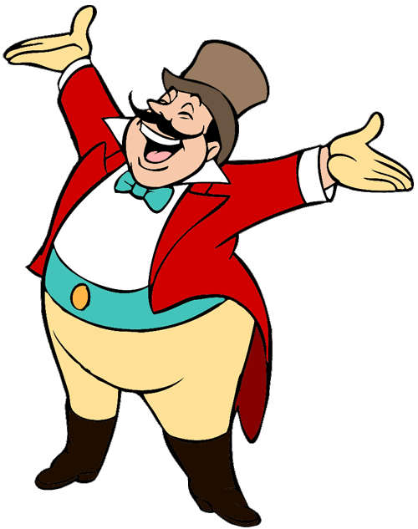
START

Slide 28



Facebook: Bùi Liễu
0968142780
A. at Quang Trung Road
B. in 9 Quang Trung Road
C. on 9 Quang Trung Road
Next

Slide 29
What does “sống”
mean in English?
A. live
B. get up
C. have lunch
Next

Slide 30

A.
B.
C.

Slide 31
A. at Quang Trung Road
B. on Quang Trung Road
C. in Quang Trung Road

Slide 32
____ do you live?
I live in Tran Hung Dao Street.
A. Who
B. When
C. Where

Slide 33
on Tran
Hung Dao Street
B. in Tran Hung Dao Street
C.at Tran Hung Dao Street

Slide 34

on 81 Tran
Hung Dao Street
B. at 81 Tran Hung Dao Street
C. in 81 Tran Hung Dao Street

Slide 35
Where do you __?
I live in Quang Trung Road.
A. eat
B. go
C. live

Slide 36
Where __ you live?
I live at 81 Tran Hung Dao Street.
A. does
B. do

Slide 37
A.
B.
C.

Slide 38


Well done!

Slide 39

3. Let’s talk.

Slide 40
Wrap up

Slide 41
Unit 11.1
Where do you live?
I live ______.
in Tran Hung Dao Street
at 9 Quang Trung Road
in Quang Trung Road
at 81 Tran Hung Dao Street

Slide 42

Facebook: Bùi Liễu
0968142780
Thank you!

