Slide 1


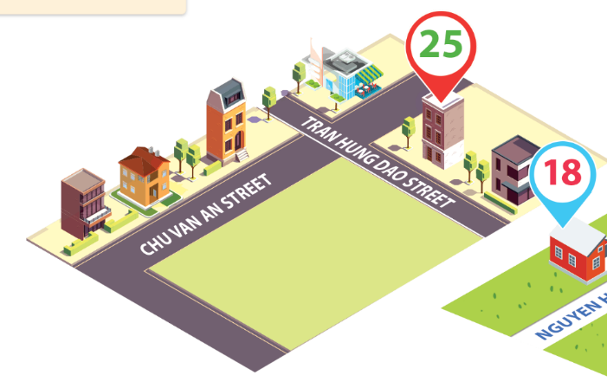
Thursday, January 20th 2026
Unit
11
MY HOME
Lesson 2: 4, 5, 6

Slide 2
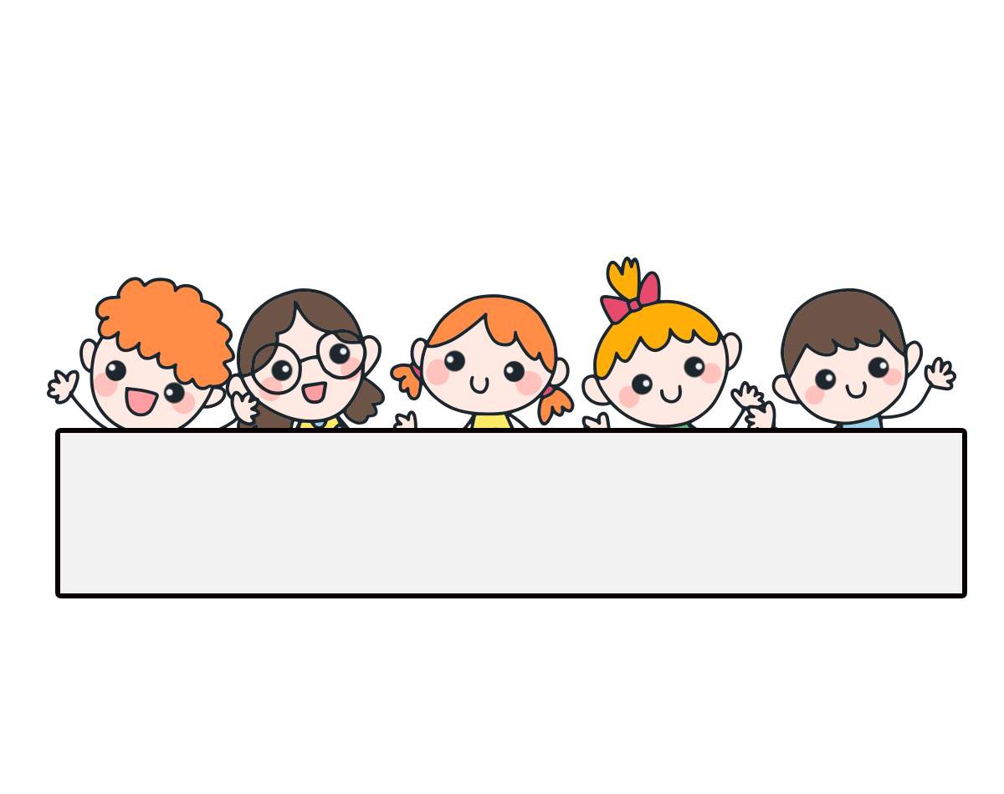
Warm-up

Slide 3








Slide 4




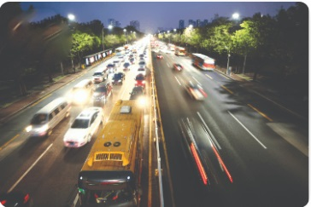
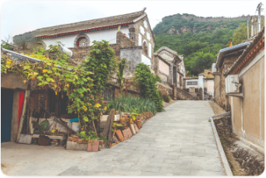


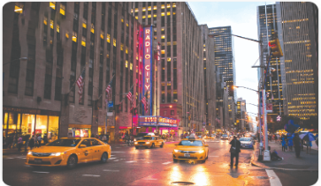
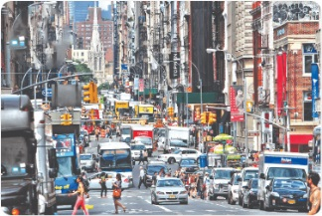
A.
B.
-1
-1
-1
+5
C.
D.
Click on the letters A, B, C or D.

Slide 5

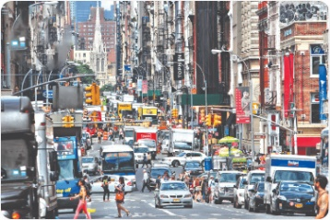
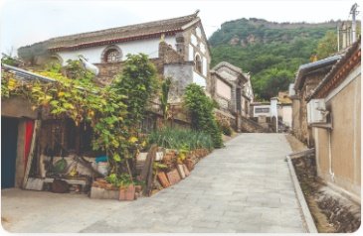

Facebook : Bùi Liễu 0968142780
A.
B.
-1
-1
-1
+5
C.
D.

Slide 6

A.
B.
-1
-1
-1
+5
C.
D.
Click on the letters A, B, C or D.

Slide 7

Facebook : Bùi Liễu 0968142780
A.
B.
-1
-1
-1
+5
C.
D.

Slide 8

What’s the city like?
______________
A. It’s a noisy city.
B.It’s a busy city.
-1
-1
-1
+5
C. It’s a quiet city.
D. It’s a big city.
Notes:
Facebook : Bùi Liễu 0968142780

Slide 9


What’s the street like?
It’s a _____ street.
A. big
B. quiet
-1
-1
-1
C. busy
D. nosy
+5

Slide 10

What’s the ____ like?
It’s a quiet _____.
A. village - village
B. town - city
-1
-1
-1
+5
C. city - village
D. village - city

Slide 11

What’s the road like?
______________
A. It’s a quiet village.
B. It’s a quiet road.
+5
-1
-1
-1
C. It’s a noisy road.
D. It’s a busy road.

Slide 12



Great job!
Exit

Slide 13
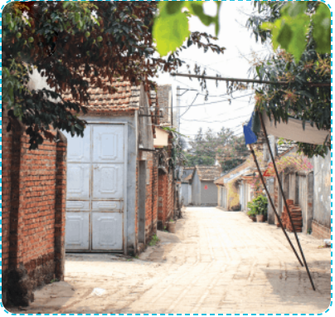
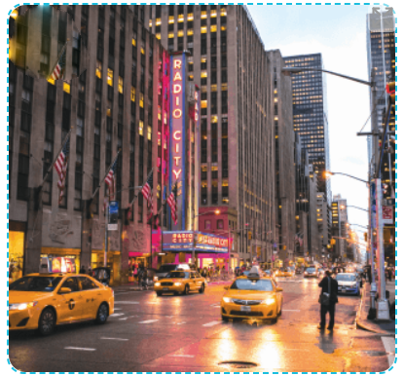
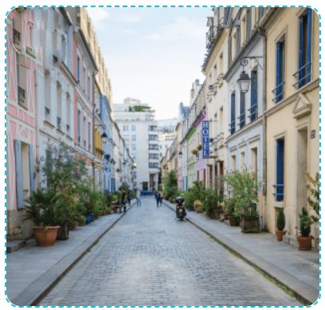
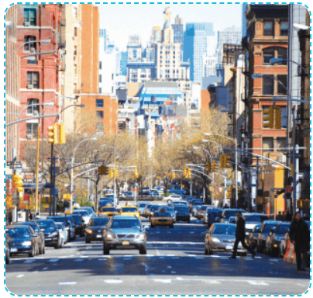



4. Listen and tick.
1.
2.
a
b
a
b

Slide 14
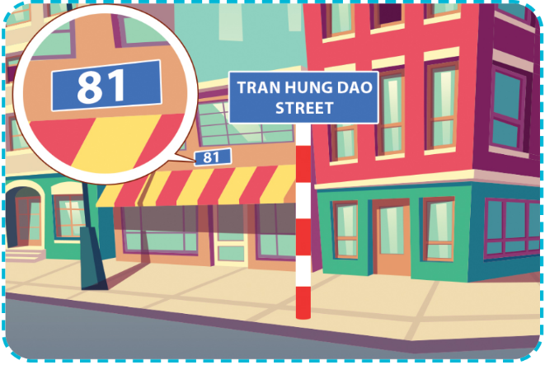
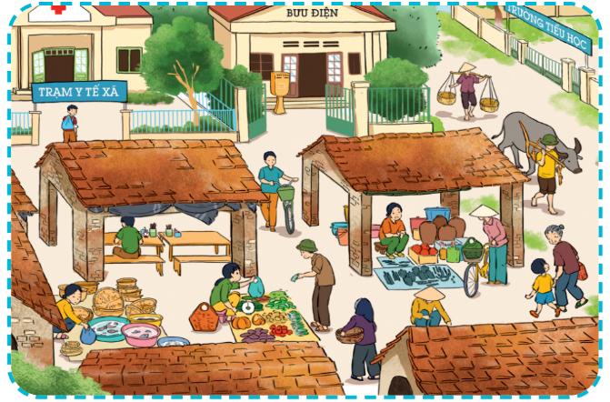
5. Look, complete and read.
1.
A: Where do you live?
B: I live at ______________________.
A: What’s the street like?
B: It’s a ________ street.
81 Tran Hung Dao Street
quiet
2.
A: Where do you ________?
B: I live in a __________.
A: ______ the village _____?
B: It’s a busy village.
live
village
What’s
like

Slide 15

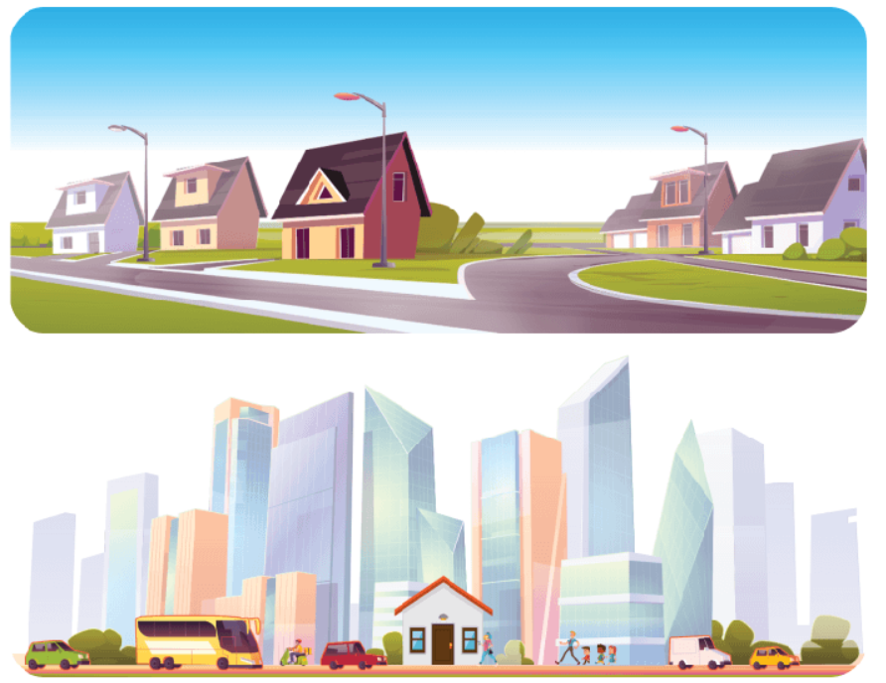







6. Let’s sing.
My house
I live in a house.
It’s a small house
In a quiet street
In a big town.
I live in a house.
It’s a small house
In a busy street
In a big city.
Facebook : Bùi Liễu 0968142780

Slide 16


Slide 17
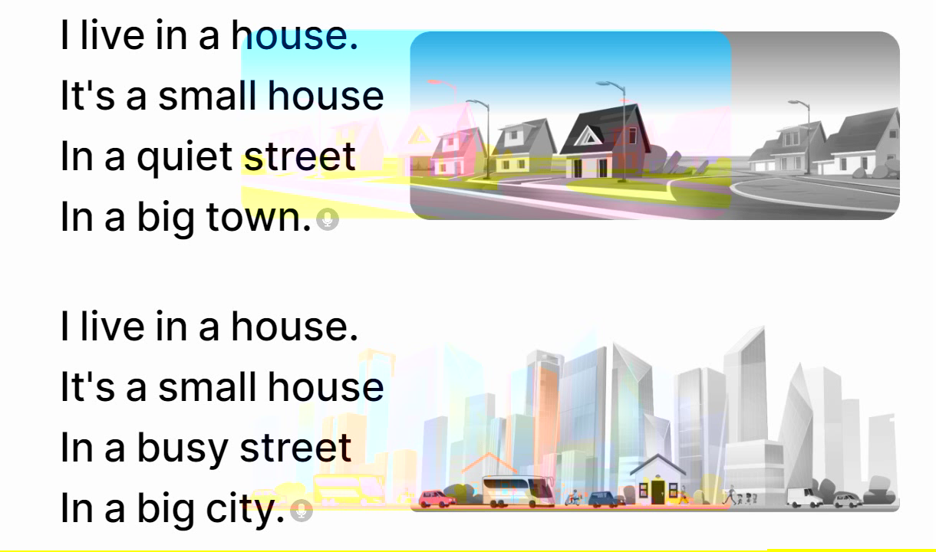
6. Let’s sing.
My house

Slide 18
Wrap up

Slide 19


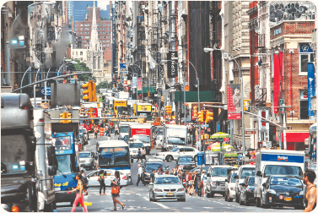



Unit 11.2
What’s the ______ like?
It’s _________.
what’s = what is
it’s = it is
a busy street
a big city
a quiet village
a noisy road

Slide 20

Thank you!

