Slide 1

Shapes
Lesson 1: Vocabulary & Sentence Patterns
(A, B, C)

Slide 2
Lesson Outline
Warm-up
Vocabulary
Structure
Practice
Consolidation
Wrap-up

Slide 3
Objectives
By the end of this lesson, students will be able to ask and answer about the shape of an object, using ….
Vocabulary:
circle, square, rectangle, triangle
Sentence pattern:
“What shape is it?” “It's a (triangle).”

Slide 4

WARM UP

Slide 5

Look and guess the feelings of each person.
CHECK-UP

Slide 6
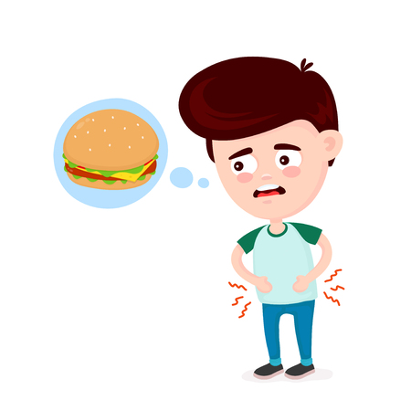

How is Quan?
Quan’s hungry.

Slide 7

How is Minh?
Minh’s bored.

Slide 8

How is David?
David’s sad.

Slide 9

How is Vy?
Vy’s Ok / fine

Slide 10
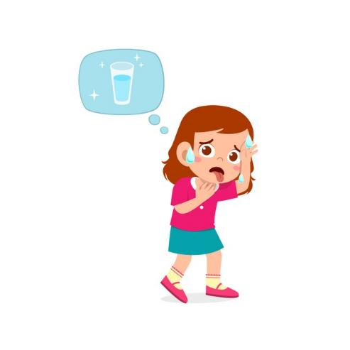
How is Lan?
Lan’s thirsty.

Slide 11

How is Peter?
Peter’s scared.

Slide 12

How is Long?
Long’s great.

Slide 13

How is Linda?
Linda’s happy.

Slide 14

It’s time to learn …

Slide 15
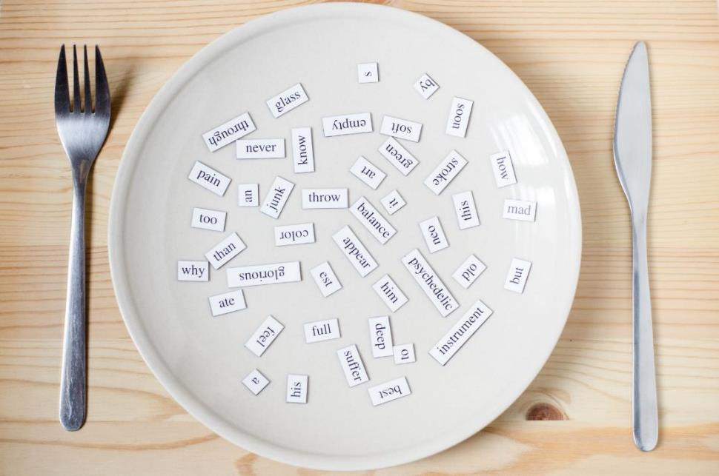
New words
circle, square, rectangle, triangle

Slide 16

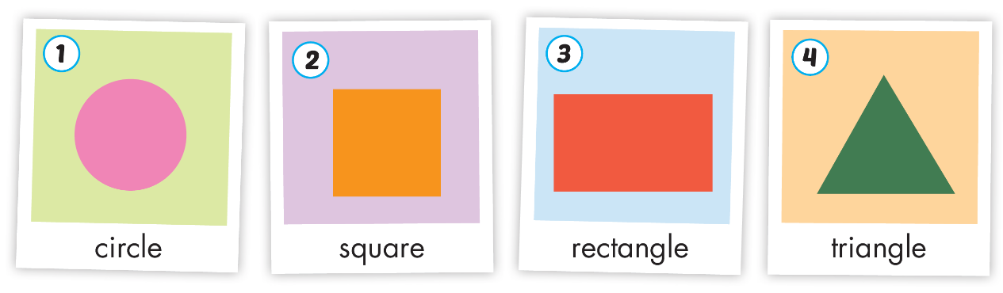
Click A to hear the sound
Notes:
Click vào hình A. 1. Listen and point. Repeat để cho cả audio full chạy

Slide 17
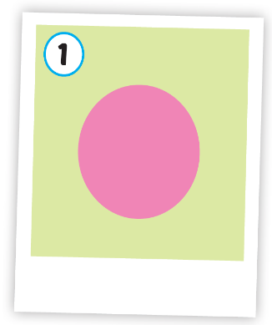
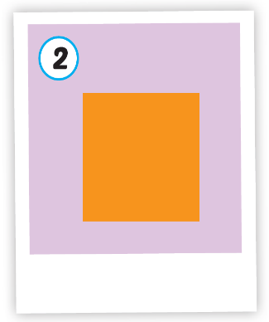
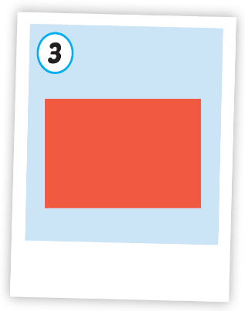
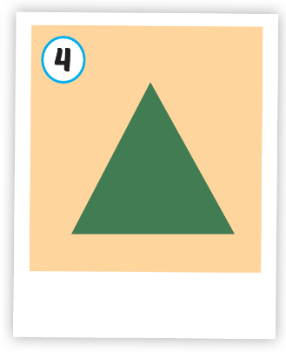




Click A to hear the sound
/ˈsɜːrkl/
hình tròn
/skweər/
hình vuông
/ˈrektæŋɡl/
hình chữ nhật
/ˈtraɪæŋɡl/
hình tam giác
Notes:
Click vào hình A. 1. Listen and point. Repeat để cho cả audio full chạy

Slide 18

Click on the picture to hear the sound
/ˈsɜːrkl/
hình tròn
Notes:
Click vào hình A. 1. Listen and point. Repeat để cho cả audio full chạy

Slide 19

Click on the picture to hear the sound
/skweər/
hình vuông
Notes:
Click vào hình A. 1. Listen and point. Repeat để cho cả audio full chạy

Slide 20

Click on the picture to hear the sound
/ˈrektæŋɡl/
hình chữ nhật
Notes:
Click vào hình A. 1. Listen and point. Repeat để cho cả audio full chạy

Slide 21

Click on the picture to hear the sound
/ˈtraɪæŋɡl/
hình tam giác
Notes:
Click vào hình A. 1. Listen and point. Repeat để cho cả audio full chạy

Slide 22

Structures
What shape is it?
It's a (triangle).

Slide 23

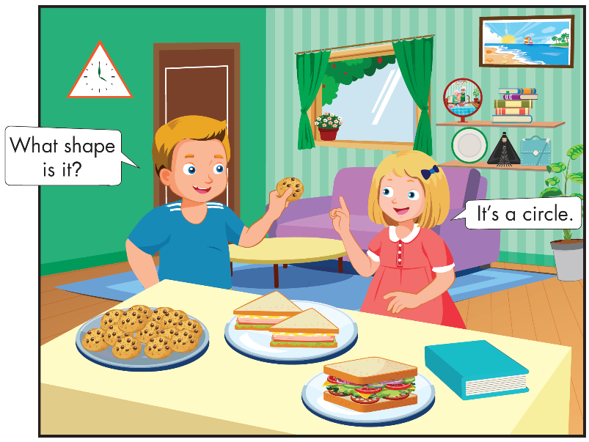
Who are they?
Notes:
B. Listen and point. Repeat. Role-play. (CD1 Track 03)
Have students call out the things they can see in each picture.
Play the audio and have them point to the characters.
Play the audio again and have them repeat the new words.
Divide the class into pairs to role-play the dialogue.
Swap roles and repeat.
Invite some pairs to demonstrate the activity in front of the whole class.
Go around the class and support them if necessary.

Slide 24
What are they talking about?
Notes:
B. Listen and point. Repeat. Role-play. (CD1 Track 03)
Have students call out the things they can see in each picture.
Play the audio and have them point to the characters.
Play the audio again and have them repeat the new words.
Divide the class into pairs to role-play the dialogue.
Swap roles and repeat.
Invite some pairs to demonstrate the activity in front of the whole class.
Go around the class and support them if necessary.

Slide 25
Notes:
B. Listen and point. Repeat. Role-play. (CD1 Track 03)
Have students call out the things they can see in each picture.
Play the audio and have them point to the characters.
Play the audio again and have them repeat the new words.
Divide the class into pairs to role-play the dialogue.
Swap roles and repeat.
Invite some pairs to demonstrate the activity in front of the whole class.
Go around the class and support them if necessary.

Slide 26

Practice

Slide 27


What shape is it?
It’s a circle.

Slide 28

What shape is it?
It’s a square.

Slide 29

What shape is it?
It’s a rectangle.

Slide 30
What shape is it?
It’s a triangle.

Slide 31


What shape is it?
What shape is it?
What shape is it?
What shape is it?
It’s a circle.
It’s a square.
It’s a circle.
It’s a square.
What shape is it?
What shape is it?
What shape is it?
What shape is it?
It’s a rectangle.
It’s a triangle.
It’s a rectangle.
It’s a triangle.
Notes:
B. Listen and point. Repeat. Role-play. (CD1 Track 03)
Have students call out the things they can see in each picture.
Play the audio and have them point to the characters.
Play the audio again and have them repeat the new words.
Divide the class into pairs to role-play the dialogue.
Swap roles and repeat.
Invite some pairs to demonstrate the activity in front of the whole class.
Go around the class and support them if necessary.

Slide 32
It’s time to play …

Slide 33






What’s next?
?
circle
square

Slide 34




What’s next?
?
circle
triagle

Slide 35





What’s next?
?
triangle
rectangle

Slide 36




What’s next?
?
circle
square

Slide 37





What’s next?
?
triangle
rectangle

Slide 38

Further Practice

Slide 39

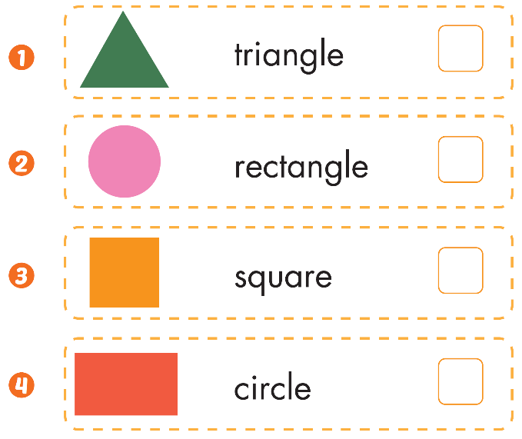



Slide 40

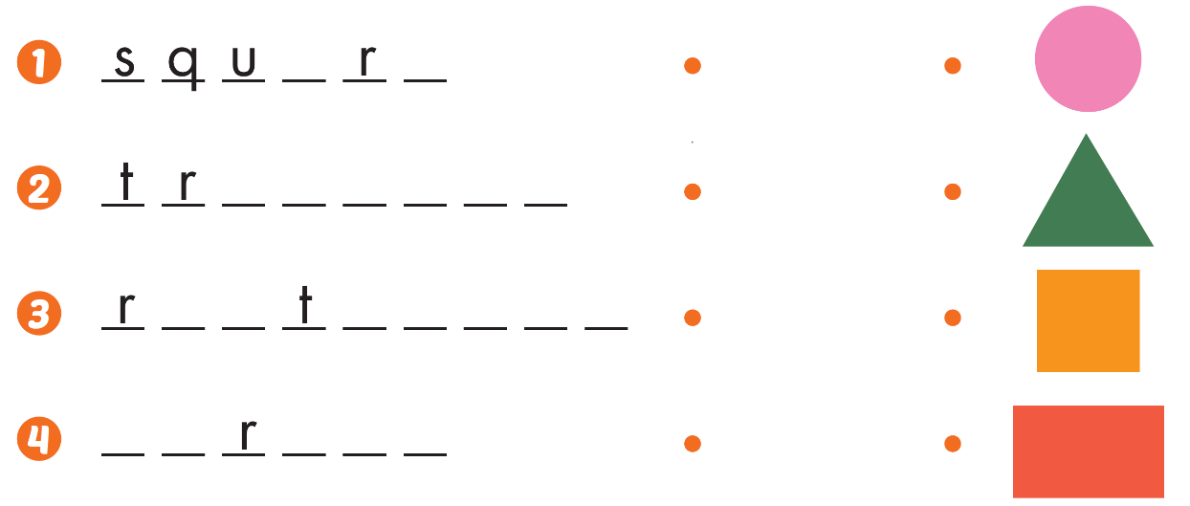
a e
i a n g l e
e c a n g l e
c i c l e

Slide 41

CONSOLIDATION

Slide 42
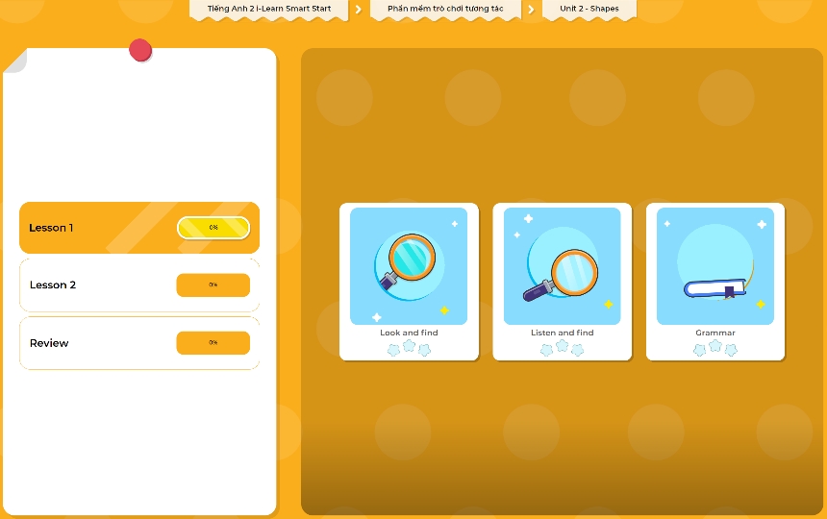
Extra Practice
DHA App
LET’S PLAY!
Click here to play the games

Slide 43

WRAP-UP

Slide 44
Today’s lesson
Structures/ Sentence patterns
What shape is it?
It's a (triangle).
Vocabulary
circle, square, rectangle, triangle

Slide 45
Homelink
Practice vocabularies and structure. Make sentences using them.
Practice the vocabulary and structure in Tiếng Anh 2 i-Learn Smart Start Notebook (page 14)
Do the exercises in Tiếng Anh 2 i-Learn Smart Start Workbook (page 14)
Play the consolidation games in Tiếng Anh 2 i-Learn Smart Start DHA App on www.eduhome.com.vn
Prepare the next lesson (page 17)

Slide 46

Enjoy your day!

