Slide 1


Slide 2

Warm-up

Slide 3

Let’s sing.

Slide 4
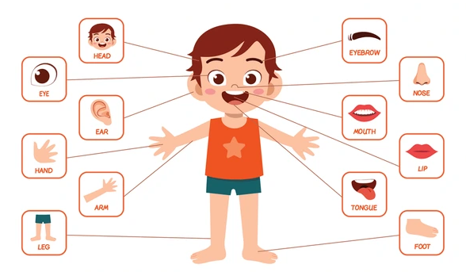
Monday, October 16th 2025
Unit 4: Our bodies
Lesson 1 (1,2,3)

Slide 5



Contents
Look, listen and repeat.
Listen, point and say.
Let’s talk.

Slide 6

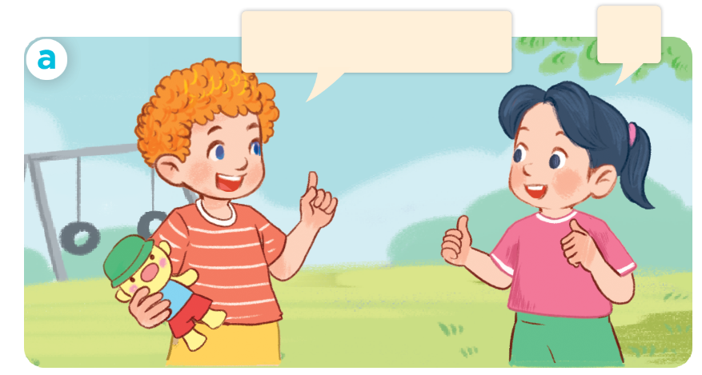
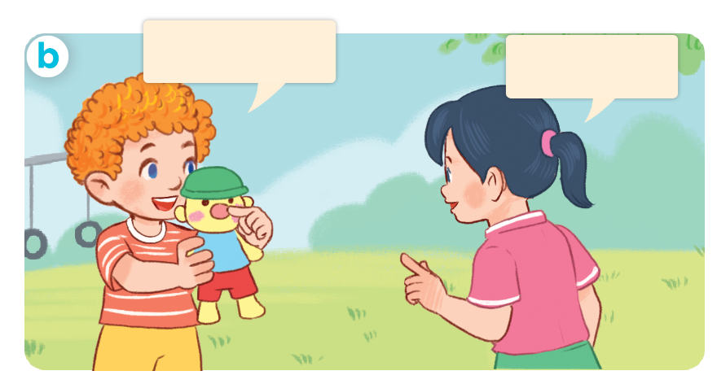
1. Look, listen and repeat.
Let’s play a game!
OK.
What’s this?
It’s a nose.
a
b
What are they doing?
Where are they?
Who are they?
Click on the speaker / sentences to listen.

Slide 7
Vocabulary

Slide 8

Vocabulary
body
/ˈbɒd.ɪ/
cơ thể
Click on the words to listen again.

Slide 9
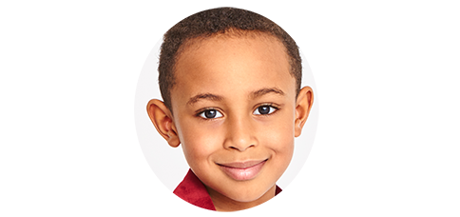
face
/feɪs/
mặt

Slide 10
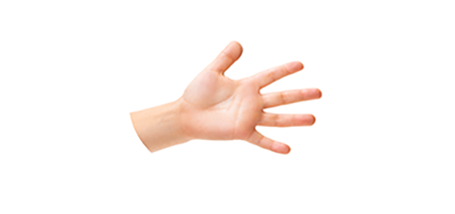
hand
/hænd/
bàn tay

Slide 11
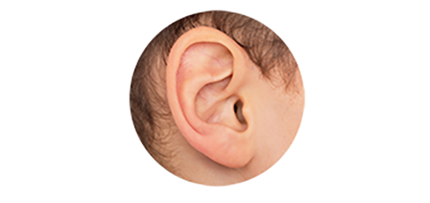
ear
/ɪə/
tai

Slide 12
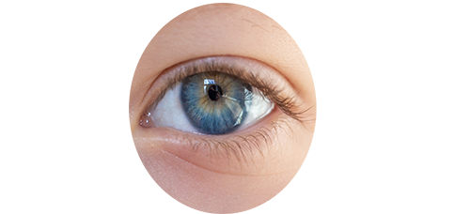
eye
/aɪ/
mắt

Slide 13
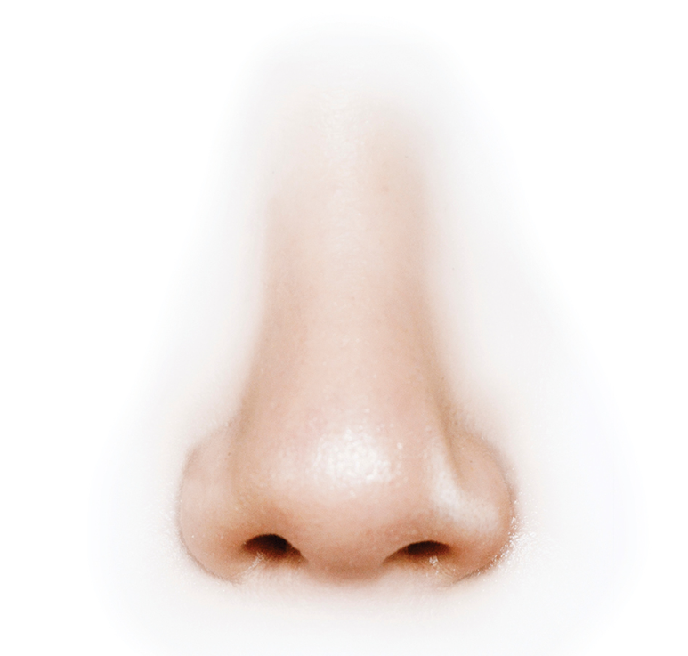
nose
/nəʊz/
mũi

Slide 14

Review
body
face
hand
ear
eye
nose
Click on the words to listen again.

Slide 15



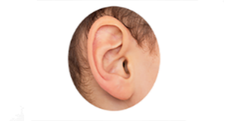
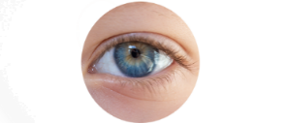
Vocabulary
1. body
: cơ thể
2. face
: mặt
3. hand
: bàn tay
4. ear
: tai
5. eye
: mắt
6. nose
: mũi
Click on the English words to listen again.

Slide 16


Checking vocabulary!

Slide 17

Can you guess?
Nhấn vào ống nhòm lần thứ nhất để chuyển động.
Nhấn lần thứ 2 để hiển thị đáp án.
1/6
eye

Slide 18
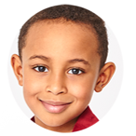
Can you guess?
2/6
face

Slide 19
Can you guess?
3/6
nose

Slide 20
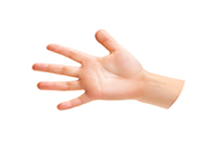
Can you guess?
4/6
hand

Slide 21

Can you guess?
5/6
body

Slide 22
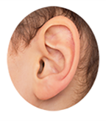
Can you guess?
6/6
ear

Slide 23
Well done!

Slide 24
Structures

Slide 25
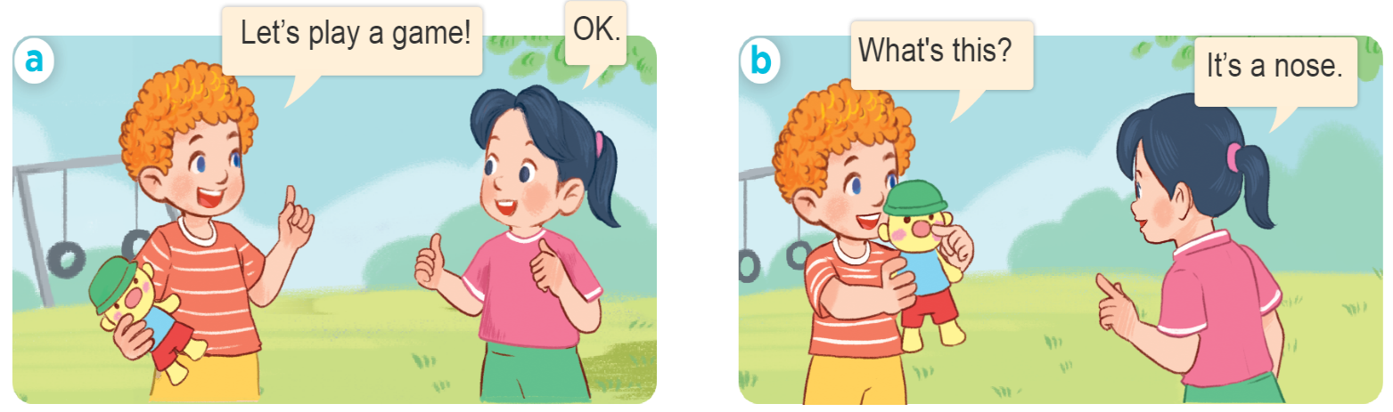
Hỏi và trả lời về bộ phận cơ thể.
- What’s this?
- It’s _______.
(Đây là gì?)
(Đó là ….)
what’s = what is
it’s = it is
Example:

Slide 26
2. Listen, point and say.
What’s this?
a
b
c
d
It’s _______.
a face
a hand
an ear
an eye
what’s = what is
It’s = it is

Slide 27


2. Listen, point and say.
a
What’s this?
It’s _______.
a face
What’s this?
It’s a face.
Click on the sentences to listen again.

Slide 28
2. Listen, point and say.
b
What’s this?
It’s _______.
a hand
What’s this?
It’s a hand.

Slide 29
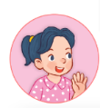

2. Listen, point and say.
c
What’s this?
It’s _______.
an ear
What’s this?
It’s an ear.

Slide 30
2. Listen, point and say.
d
What’s this?
It’s _______.
an eye
What’s this?
It’s an eye.

Slide 31

Let’s play!

Slide 32
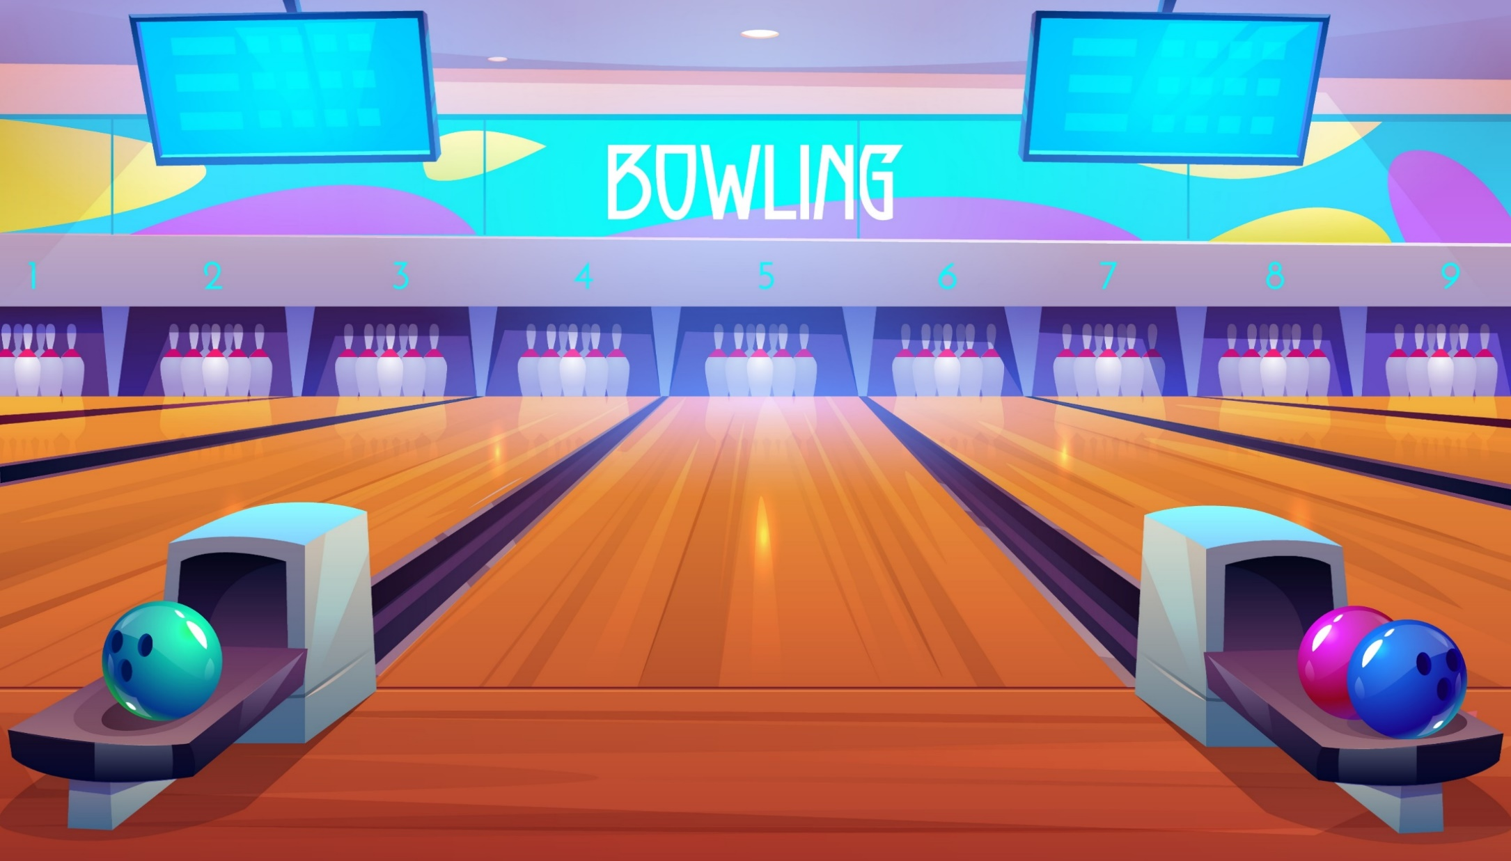
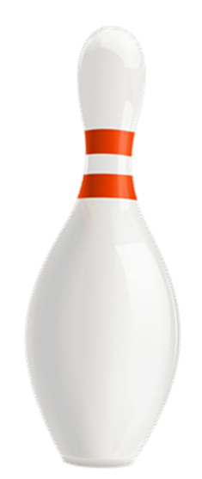



Slide 33
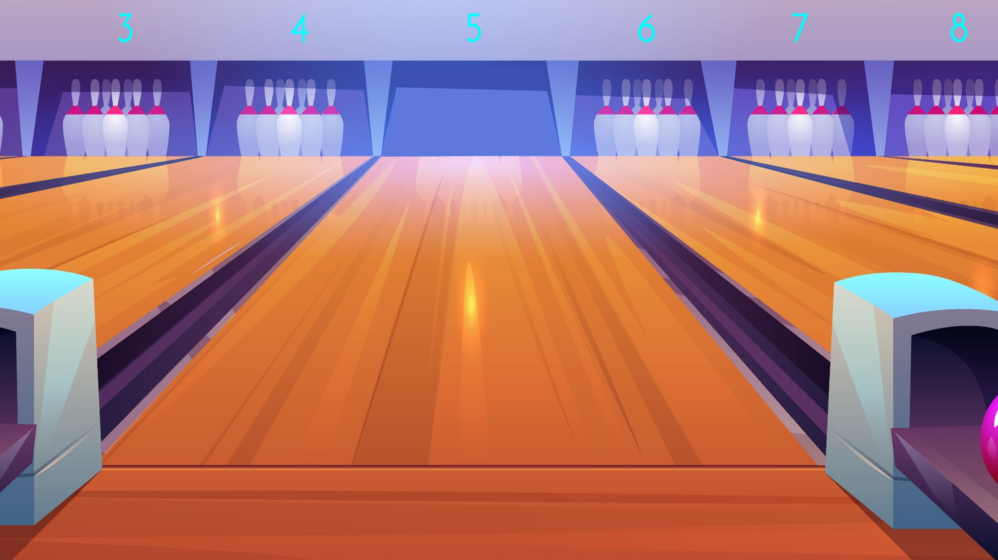





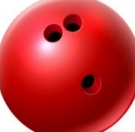
A. hand
B. face
C. ear
Next

Slide 34

A. hand
B. eye
Facebook : Bùi Liễu
0968142780
C. nose
Next

Slide 35

A. body
B. hand
C. eye
Next

Slide 36
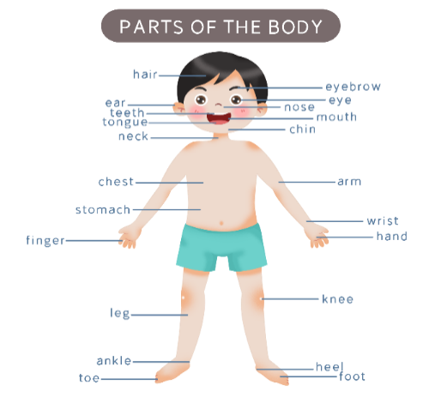
A. body
B. face
C. nose
Next

Slide 37

A. ear
B. eye
Facebook : Bùi Liễu
0968142780
C. hand
Next

Slide 38
A. face6
B. eye
C. nose
Next

Slide 39

A. that
this
A: What’s ____?
B: It’s a face.
Next

Slide 40
A. a
B. an
A: What’s this?
B: It’s ___ ear.
C. the
Next

Slide 41

A. a
B. the
Facebook : Bùi Liễu
0968142780
A: What’s this?
B: It’s __ hand.
C. an
Next

Slide 42

A. an
B. a
A: What’s this?
B: It’s __ face.
Next

Slide 43
A. How
A: _____ this?
B: It’s an eye.
B. What’s
Next

Slide 44
A. an
A: What’s this?
B: It’s __ nose.
B. a
Next

Slide 45


WELL DONE!

Slide 46

3. Let’s talk.
1
What’s this?
1
5
5
2
2
4
4
It’s an ear
3
_________.
3
It’s a nose
It’s an eye
It’s a face
It’s a hand

Slide 47
Let’s guess!

Slide 48








Slide 49


A. It’s an eye.
B. It’s an ear.
C. It’s a hand.
D. It’s a face.
It’s an ear.

Slide 50
A. It’s an ear.
B. It’s an eye.
C. It’s a face.
D. It’s a hand.
It’s a hand.

Slide 51
A. It’s an eye.
B. It’s a hand.
C. It’s a face.
D. It’s a nose.
It’s a face.

Slide 52
A. It’s a hand.
B. It’s an eye.
C. It’s an ear.
D. It’s a face.
It’s an eye.

Slide 53
A. It’s a face
B. It’s a nose.
C. It’s a hand.
D. It’s an eye.
It’s a nose.

Slide 54
Facebook : Bùi Liễu
0968142780
Good job!

Slide 55
Homelink
Learn by heart all the new words and the model sentences.
Read again the dialogue in part 1.

Slide 56

Thank you!

