Slide 1


Slide 2
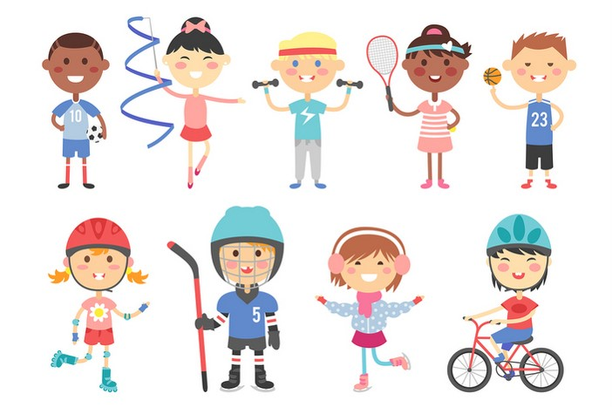
Tuesday, October 27th 2025
My hobbies
Unit
5
Lesson 1(1,2,3)

Slide 3

Warm-up

Slide 4



Let’s sing.
Ears,
ears,
ears.
Hair,
hair,
hair.
Touch your ears!
Touch your hair!
Touch your ears!
Touch your hair!

Slide 5



Contents
Look, listen and repeat.
Listen, point and say.
Let’s talk.

Slide 6

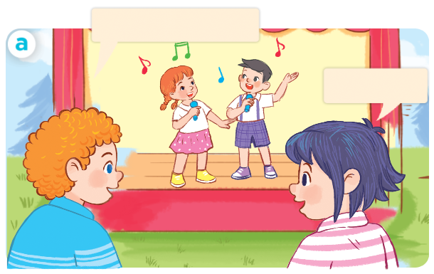
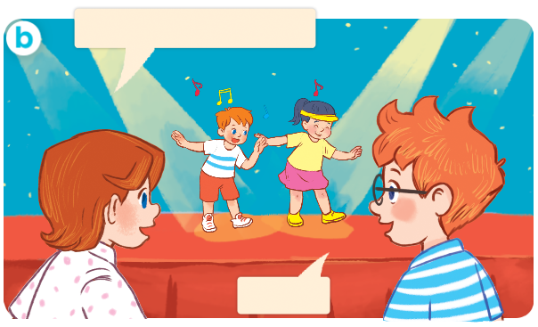
1. Look, listen and repeat.
Click on the speaker / sentences to listen.
What’s your hobby?
What’s your hobby, Ben?
It’s singing.
Dancing.
What are they doing?
Where are they?
Who are they?
Click on the screen to show 3 questions.

Slide 7
Vocabulary

Slide 8


Vocabulary
hobby
/ˈhɒb.i/
sở thích
Click on the words to listen again.

Slide 9

Vocabulary
singing
/ˈsɪŋ.ɪŋ/
hát

Slide 10
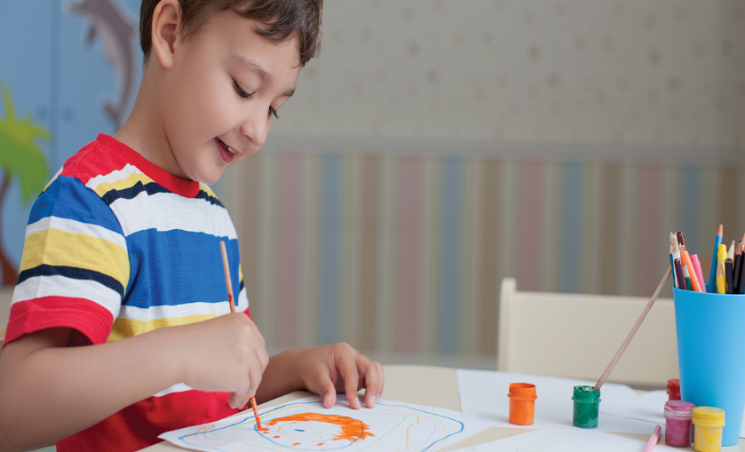
drawing
/ˈdrɔː.ɪŋ/
vẽ

Slide 11
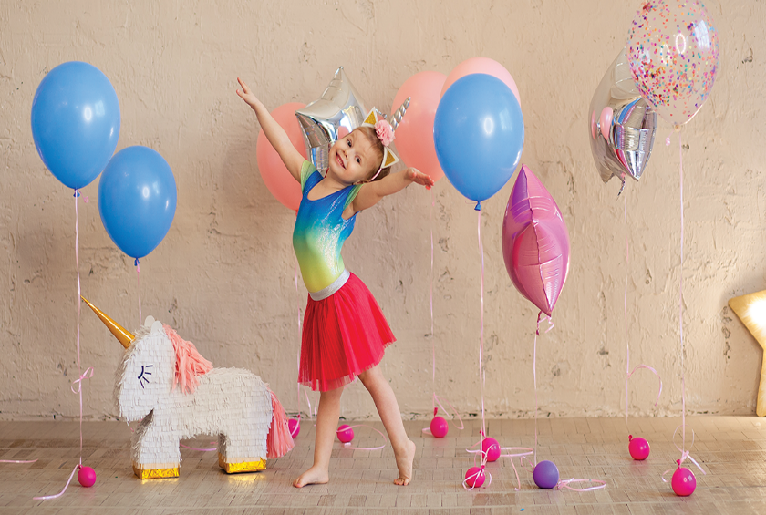
dancing
/dɑːnsɪŋ/
khiêu vũ

Slide 12
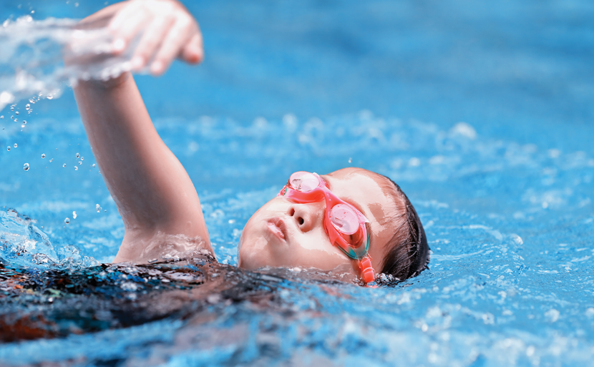
swimming
/ˈswɪm.ɪŋ/
bơi

Slide 13

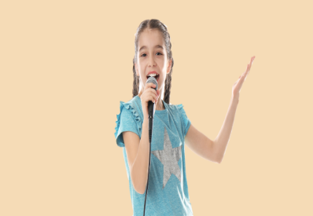
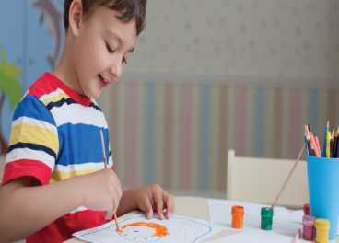


Review
hobby
singing
drawing
dancing
swimming

Slide 14





Vocabulary
1. hobby
: sở thích
2. singing
: hát
3. drawing
: vẽ
4. dancing
: khiêu vũ
5. swimming
: bơi

Slide 15
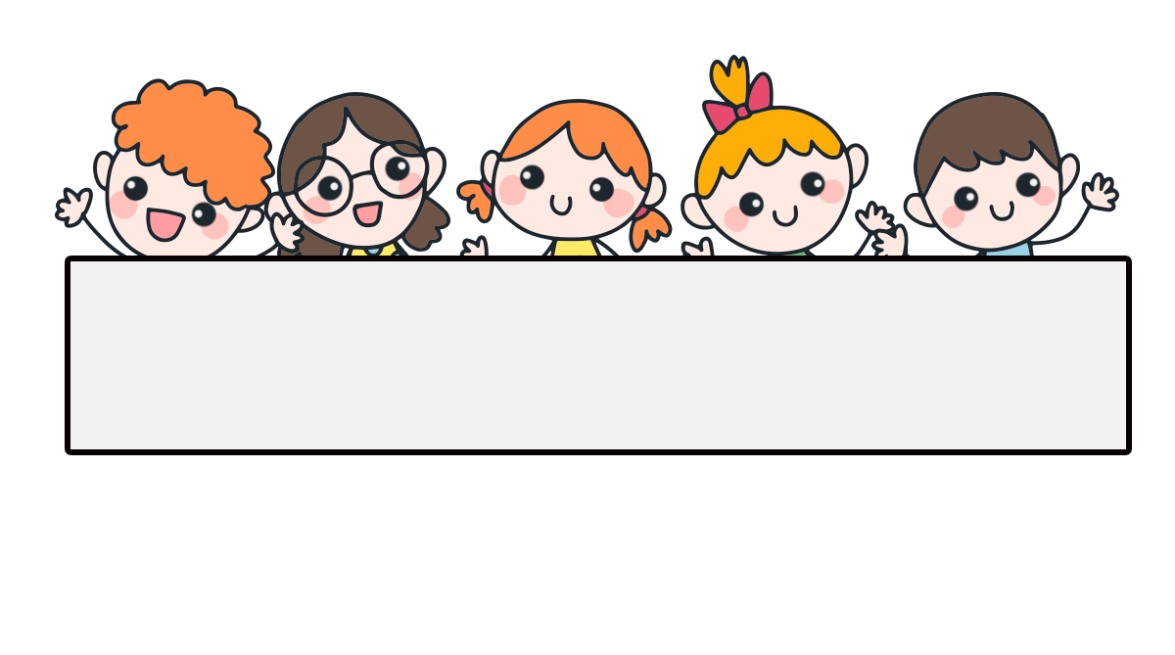
Checking vocabulary

Slide 16
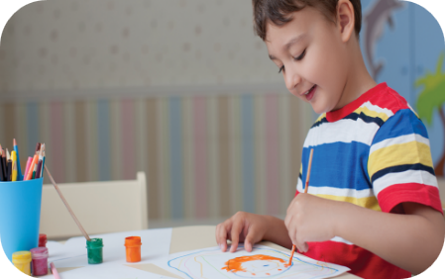
Can you guess?
drawing

Slide 17
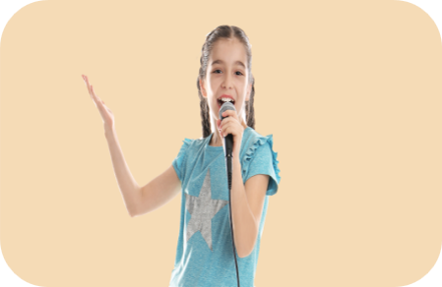
Can you guess?
singing

Slide 18

Can you guess?
hobby

Slide 19
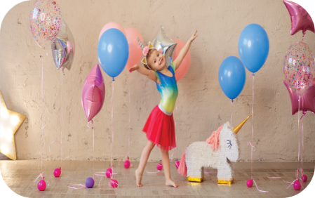
Can you guess?
dancing

Slide 20
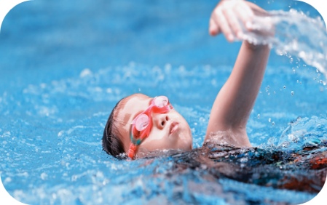
Can you guess?
swimming

Slide 21

Well done!

Slide 22
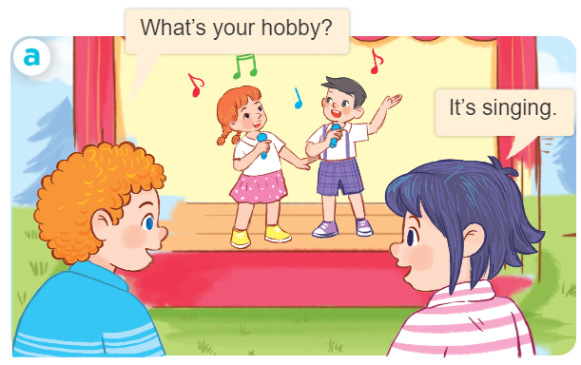
Structures
Hỏi và trả lời về sở thích.
(Sở thích của bạn là gì?)
- What’s your hobby?
It’s _______.
(Đó là ________)
What’s = what is
It’s = it is

Slide 23





2. Listen, point and say.
a
b
What’s your hobby?
singing
drawing
It’s ______.
c
d
what’s = what is
it’s = it is
dancing
swimming

Slide 24
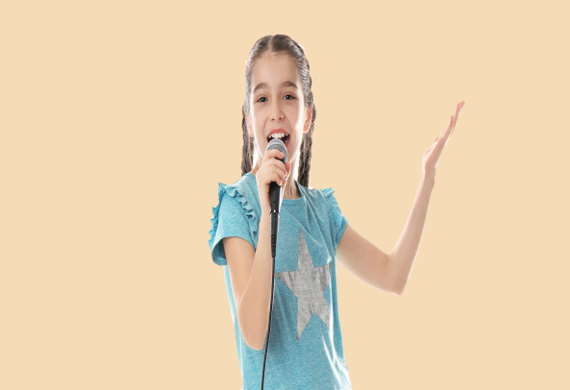

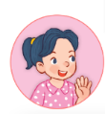
2. Listen, point and say.
a
What’s your hobby?
It’s ______.
singing
What’s your hobby?
It’s singing.
Click on the sentences to listen again.

Slide 25
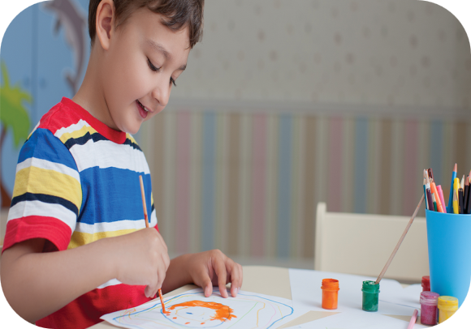
2. Listen, point and say.
b
What’s your hobby?
It’s ______.
drawing
What’s your hobby?
It’s drawing.

Slide 26
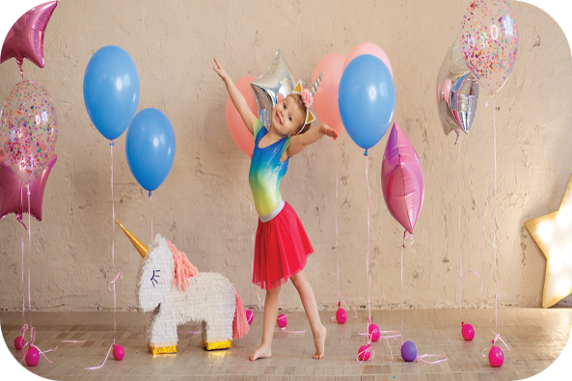
2. Listen, point and say.
c
What’s your hobby?
It’s ______.
dancing
What’s your hobby?
It’s dancing.

Slide 27
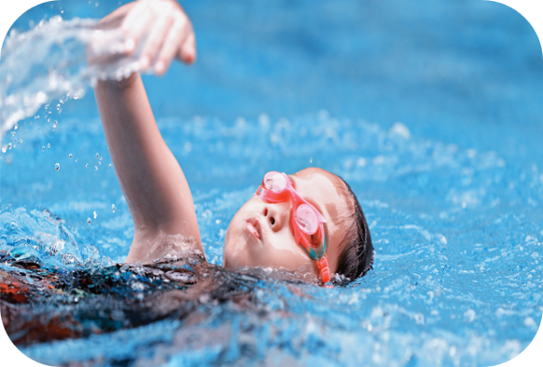
2. Listen, point and say.
d
What’s your hobby?
It’s ______.
swimming
What’s your hobby?
It’s swimming.

Slide 28
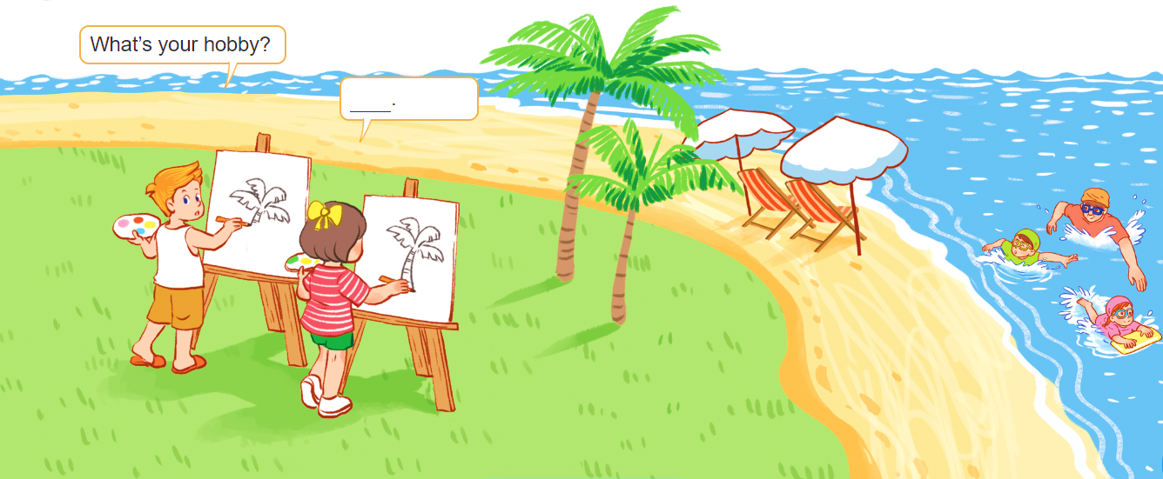
3. Let’s talk.
What’s your hobby?
It’s drawing
__________.

Slide 29

Let’s play!

Slide 30








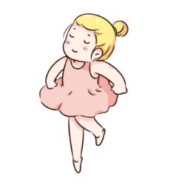

Choose the right answer.
swimming
a
b
c

Slide 31

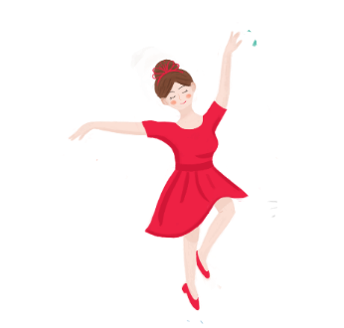



singing
a
b
c

Slide 32
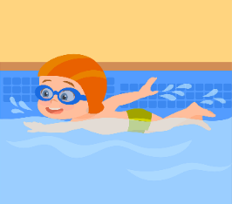

dancing
a
b
c

Slide 33

drawing
a
b
c

Slide 34

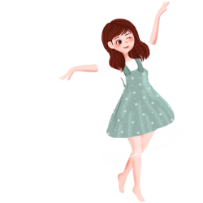
a
b
c

Slide 35
a
b
c

Slide 36

a
b
c

Slide 37
A: What’s ____ hobby?
B: It’s dancing.
my
your
a
b

Slide 38
A: ____ is your hobby?
B: It’s singing.
How old
What
How
a
b
c

Slide 39

A: What’s your ____?
B: It’s swimming.
name
hobby
a
b

Slide 40

Thank you!

Slide 41
Homelink
Learn by heart all the new words and the model sentences.
…………………………………………..

Slide 42

Thank you!

