Slide 1

Unit 9: Classroom activities
Lesson 2.2: Vocabulary & Phonics
Page: 61

Slide 2
Lesson Outline
Warm-up
Phonics
Practice
Consolidation
Wrap-up

Slide 3
Objectives
By the end of this lesson, students will be able to gain the following:
Phonics: /v/ and /w/
Vocabulary:
violin, window, vest
Sentence pattern:
Revision.
Skills:
Recognize letters V/v and W/w and the sound /v/; /w/ in words and produce them individually.

Slide 4

WARM UP

Slide 5
Review
Letter Vv and Ww

Slide 6



Letter Vv
violin
vest

Slide 7


Letter Ww
watch
window

Slide 8

It’s time to learn …

Slide 9

Phonics
/v/, /w/

Slide 10


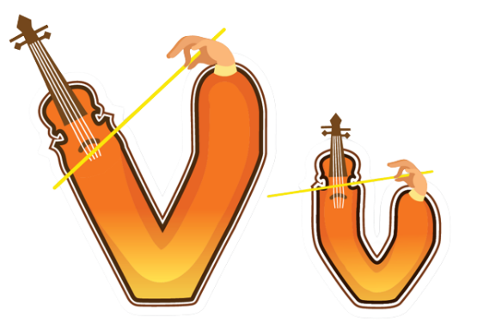

Notes:
Click vào hình A. 1. Listen and point. Repeat để cho cả audio full chạy

Slide 11

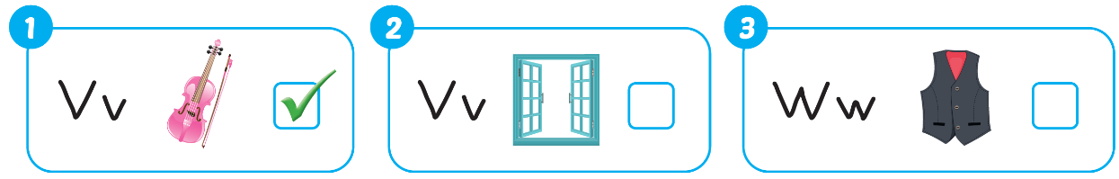

Notes:
Click vào hình A. 1. Listen and point. Repeat để cho cả audio full chạy

Slide 12

Practice

Slide 13

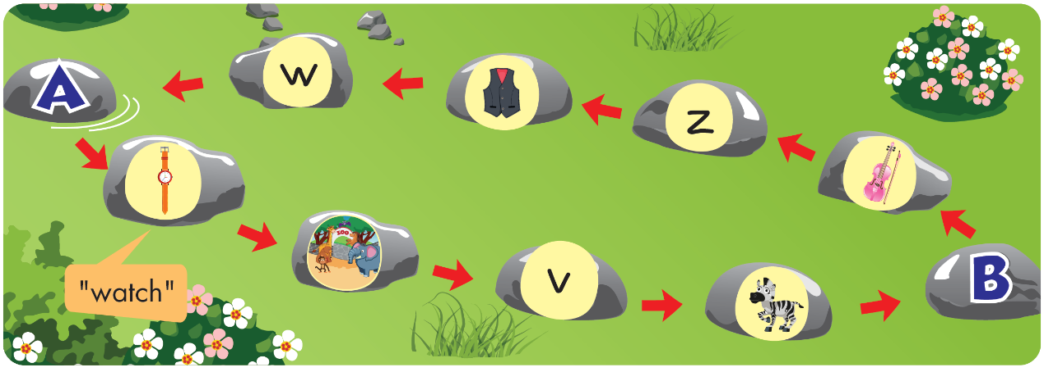
Notes:
Click vào hình A. 1. Listen and point. Repeat để cho cả audio full chạy

Slide 14
It’s time to play …

Slide 15

Letter W is for….
watch

Slide 16

Letter V is for….
violin

Slide 17

Letter Z is for….
zoo

Slide 18
What sound is this?
“z”

Slide 19
What sound is this?
“v”

Slide 20
Letter V is for….
vest

Slide 21
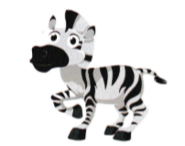
Letter Z is for….
zebra

Slide 22
What letter is this?
W

Slide 23

Further Practice

Slide 24

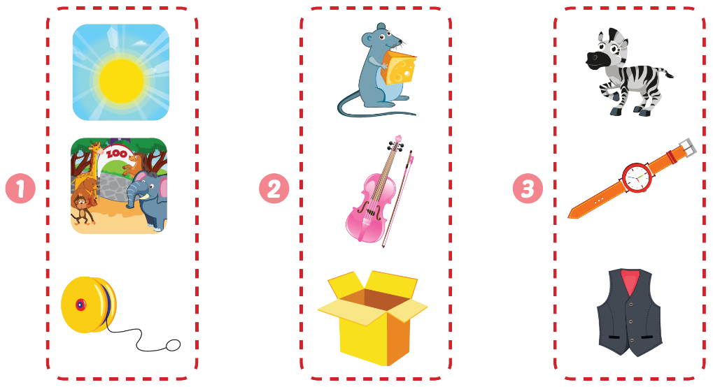





Slide 25

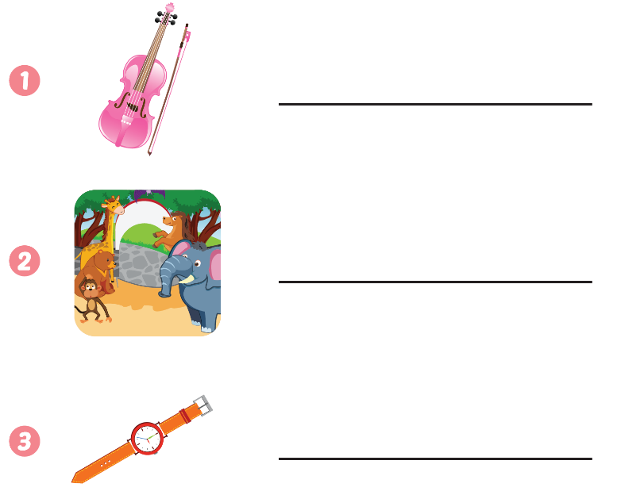
violin
zoo
watch

Slide 26

CONSOLIDATION

Slide 27
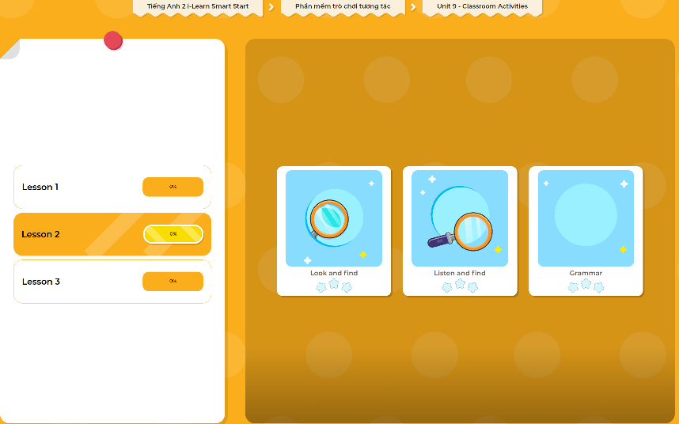
Extra Practice
DHA App
LET’S PLAY!
Click here to play the games

Slide 28

WRAP-UP

Slide 29
Today’s lesson
Phonics
/v/, /w/
Vocabulary
violin, window, vest

Slide 30
Homework
Practice vocabularies and phonics. Make sentences using them.
Practice the vocabulary and phonics in Tiếng Anh 2 i-Learn Smart Start Notebook (page 59)
Do the exercises in Tiếng Anh 2 i-Learn Smart Start Workbook (page 59)
Play the consolidation games in Tiếng Anh 2 i-Learn Smart Start DHA App on www.eduhome.com.vn
Prepare the next lesson (page 62)

Slide 31

Enjoy your day!

